Slide 1

Campus Meeting
FY 2023 Close-Out
FY 2024 Implementation
Preeminence with Purpose
“Sustaining our Legacy through Access, Leadership and Transformative Excellence”
June 28, 2023
Dr. Makola Abdullah, President
Dr. Donald Palm, Executive Vice President & Provost
Mr. Kevin Davenport, Senior Vice President for Finance and Administration
Ms. Adrian Petway, Associate Vice President for Budget and Finance
Ms. Cynthia Pegram Ervin, Budget Supervisor
Ms. Mary Weaver, Budget Supervisor

Slide 2
Agenda
Welcome
FY 2023 Close-Out
FY 2024 Budget Overview
FY 2024 Implementation

Slide 3
FY 2023 Close-Out

Slide 4
Year End for FY 2023
Review your accounts for deficits and encumbrances
If encumbrances are not needed, complete a cancellation form and submit to Purchasing
Remember to complete your Bank of America reconciliation if you have not already done so
Begin to establish a process to manage your budget next year!

Slide 5
FY 2024 Budget Overview

Slide 6

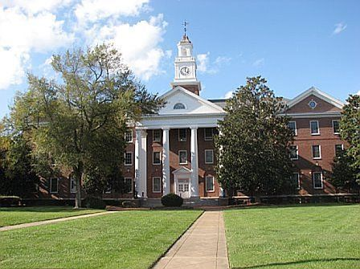
Planning & Budget Development Timeline
Due Date | Action
February 15, 2023 | Distribution of Budget Information
February 20, 2023 – March 10, 2023 | Budget Working Sessions
March 13, 2023 | Final budget requests due to your respective Vice President
March 17, 2023 | Final budget requests Due to Budget Office
March 20, 2023 – March 24, 2023 | Budget Office Prepares Budget Packages
March 27, 2023 | VP of Finance Final Discussion with President
April 20-21, 2023 | BOV Approves FY 2024 Budget
June 23, 2023 | Notification of Approved Budget Amendments will be communicated via email. Campus wide meeting held on June 28, 2023
July 1, 2023 – July 5, 2023 | FY 24 NPS Budgets loaded to BANNER

Slide 7
UNIVERSITY OPERATING BUDGET
Fiscal Year 2023-24
Key Highlights
The University operates on an annual Fiscal Year: July 1 – June 30
Departments had the opportunity to request increases to their base budget and for new initiatives to move the University forward
Budget Increases:
Funded new initiatives from departments
Mandatory contract increases
5% salary increases
Utility rate increases
New State Funding of $21.5M for special initiatives

Slide 8


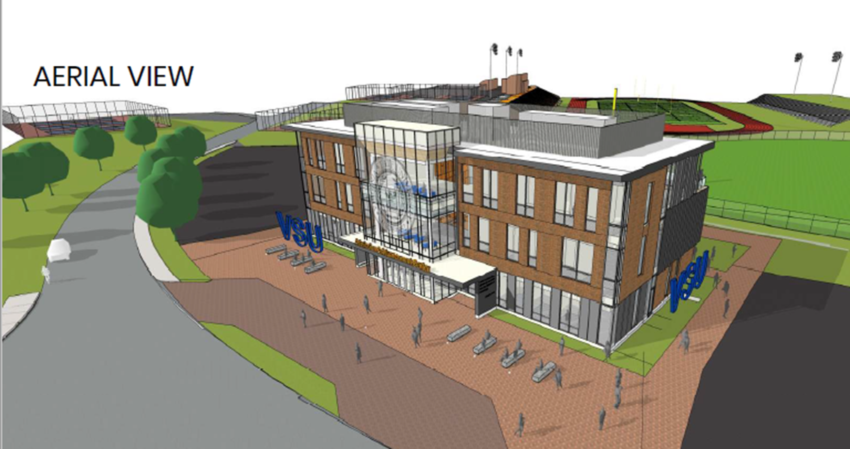
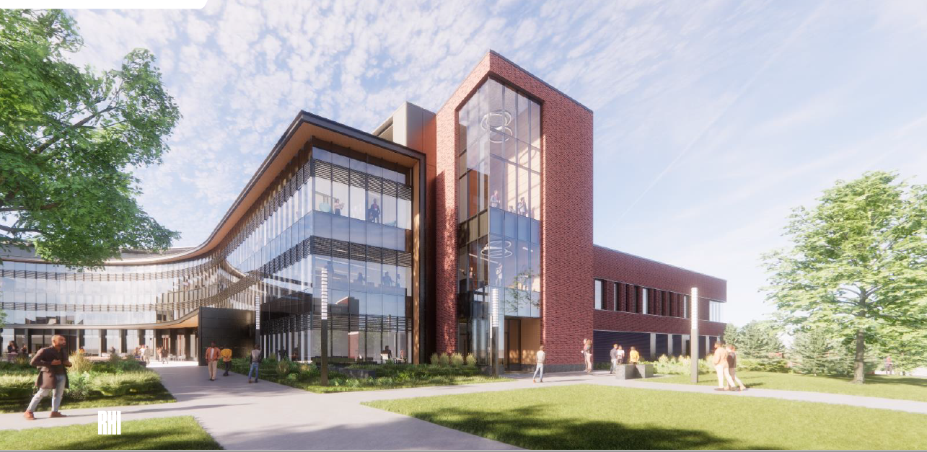
INCREASED
STATE SUPPORT
2023-24
Affordable Access
Degree and Online Programs
Advanced Manufacturing Logistics Institute
Academic Success Initiatives
VSU Pipeline with a Purpose
Degree Completion & Career Enhancement Initiative
Increase In-State & Graduate Financial Assistance

Slide 9

KEY BUDGET DRIVERS
Fiscal Year 2023-24
 | Budget |  | Actual
 | Fall 2023 | Fall 2022 | Fall 2022 | Fall 2021 | Fall 2020
Head Count | 4,400 | 4,100 | 4,648 | 4,300 | 4,025
Full-Time | 4,099 | 3,871 | 4,286 | 3,909 | 3,735
On-Campus | 3,200 | 2,200 | 2,736 | 2,271 | 0
Head Count

Slide 10
BUDGETED REVENUES
Fiscal Year 2023-24
 | FY 2024 | FY 2023 | $ Change
Educational & General | $ 105,739,541 | $ 79,812,083 | $ 25,927,458
Auxiliary Enterprises | 57,063,145 | 41,772,798 | 15,290,347
Sponsored Programs | 28,447,617 | 28,447,617 | -
State Financial Assistance | 31,593,348 | 25,647,348 | 5,946,000
Agriculture Research & Extension | 19,503,994 | 16,125,378 | 3,378,616
CARES Funds | 5,000,000 | 20,984,781 | (15,984,781)
Local Funds | 6,439,151 | 4,439,151 | 2,000,000
TOTAL | $ 253,786,796 | $ 217,229,156 | $ 36,557,640

Slide 11
PROPOSED BUDGETED EXPENDITURES
Fiscal Year 2023-24
 | FY 2024 | FY 2023 | $ CHANGE
Instruction | $ 59,214,143 | $ 42,719,461 | $ 16,494,682
Auxiliary Enterprises | 57,063,145 | 41,772,798 | 15,290,347
Student Financial Assistance | 31,593,348 | 25,647,348 | 5,946,000
Sponsored Programs | 28,447,617 | 28,447,617 | -
Institutional Support | 22,205,305 | 15,836,534 | 6,368,771
Agriculture Research & Extension | 19,503,994 | 16,125,378 | 3,378616
Operation & Maintenance | 10,573,954 | 6,122,690 | 4,451,264
CARES Stimulus Funds | 5,000,000 | 20,984,781 | (15,984,781)
Academic Support | 6,344,372 | 7,404,928 | (1,060,556)
Student Support | 5,815,675 | 6,365,099 | (549,424)
Local Funds | 6,439,151 | 4,439,151 | 2,000,000
Research & Extension | 1,586,093 | 1,363,371 | 222,722
TOTAL | $ 253,786,796 | $ 217,229,156 | $ 36,557,640

Slide 12
FY 2024 Implementation

Slide 13
FY 2024 Implementation
Personal Services Budgets – Base will be loaded prior to Banner open
Other PS Budgets – Wage, adjuncts, overtime
Non-Personal Services Budgets – Base will be loaded prior to Banner open
Budget Management
Moving Forward

Slide 14
Budget Contacts
Mary Weaver – mweaver@vsu.edu Board of Visitors, President, Auxiliaries (AE), Finance (AE), Technology Services, Police and Public Safety
Cynthia Pegram Ervin cpegram@vsu.edu – College of Agriculture (E&G) and Agency 234 , Internal Audit, Finance (E&G), External Relations
Barbara Taylor btaylor@vsu.edu – Budget Assistant
Nya Wilkins nwilkins@vsu.edu – Budget Assistant
Joyce Wilkins/Sheila Phillips – jwilkins@vsu.edu, sphillips@vsu.edu – Provost Area

Slide 15

Questions?
Comments.
Concerns.

