Slide 1
FY 2024
Planning & Budget Development Workshop
Preeminence with Purpose
“Sustaining our Legacy through Access, Leadership and Transformative Excellence”
February 15, 2023
Dr. Makola Abdullah, President
Dr. Donald Palm, Executive Vice President & Provost
Mr. Kevin Davenport, Senior Vice President for Finance and Administration
Ms. Adrian Petway, Associate Vice President for Budget and Finance
Ms. Joyce Wilkins, Executive Director for Financial Planning and Analysis

Slide 2
Agenda
Welcome
FY 2023 Budget Overview (current year)
FY 2024 Budget Development Process
FY 2024 Budget Timeline and Instructions

Slide 3
Senior Vice President for Finance and Administration
FY 2023 Budget Overview

Slide 4


Slide 5
USES

Slide 6

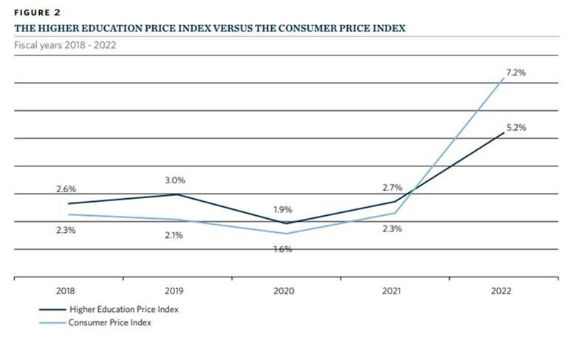



INFLATION

Slide 7


KEY BUDGET DRIVERS
FALL 2022
 | Budget | Actual | Change | % Increase
Head Count | 4,100 | 4,648 | +548 | 13%
Full-Time | 3,871 | 4,286 | +415 | 11%
On-Campus | 2,200 | 2,989 | +789 | 36%
% Out of State | 27% | 27%

Slide 8

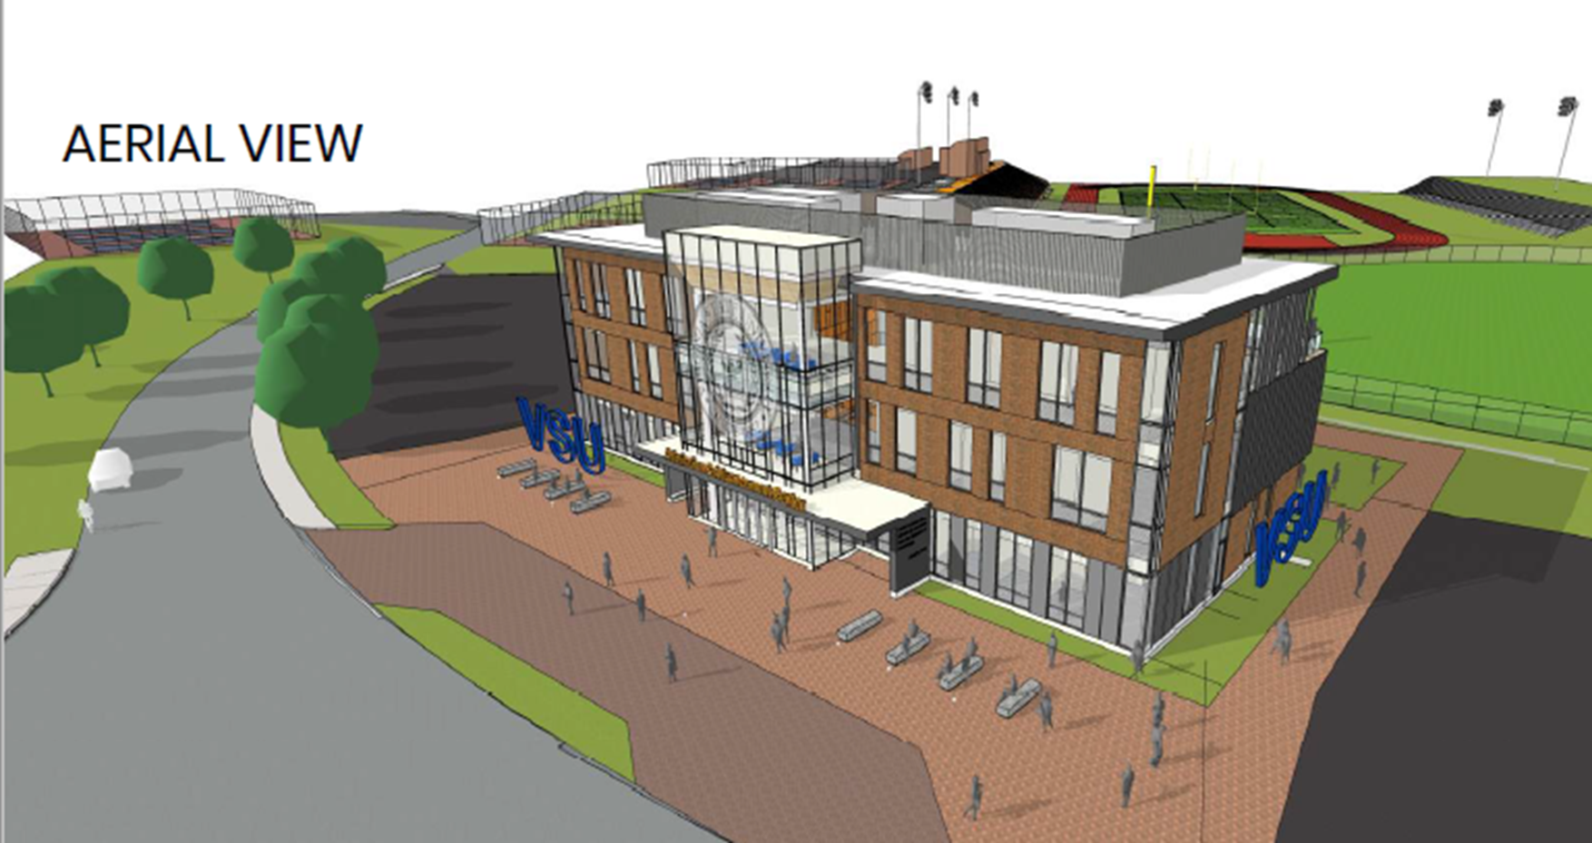
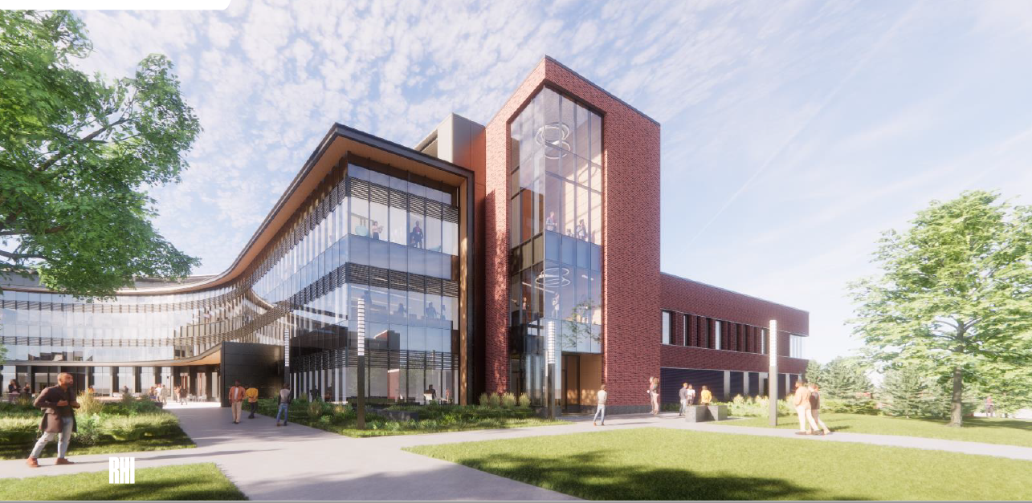
INCREASED
STATE SUPPORT
2022-23
Affordable Access
Degree and Online Programs
Advanced Manufacturing Logistics Institute
Academic Success Initiatives
VSU Pipeline with a Purpose
Degree Completion & Career Enhancement Initiative
Increase In-State & Graduate Financial Assistance

Slide 9

COMPARATIVE IN-STATE TUITION & FEE RATES
FY 2022 - 2023
Four-Year Undergraduate Program | Full-time Tuition | Mandatory Fees | Total
Norfolk State University | 5,752 | 3,870 | 9,622
Virginia State University* | 6,269 | 3,385 | 9,654
UVA-Wise | 6,224 | 5,274 | 11,498
Old Dominion University | 7,257 | 4,373 | 11,630
Radford University | 8,252 | 3,664 | 11,916
James Madison University | 7,684 | 5,408 | 13,092
George Mason University | 9,795 | 3,609 | 13,404
University of Mary Washington | 8,998 | 5,296 | 14,294
Longwood University | 8,420 | 6,180 | 14,600
Virginia Polytechnic & State University | 12,289 | 2,377 | 14,666
Christopher Newport University | 9,375 | 6,050 | 15,425
Virginia Commonwealth University | 12,956 | 2,686 | 15,642
University of Virginia | 15,339 | 2,889 | 18,228
Virginia Military Institute | 9,782 | 10,132 | 19,914
College of William & Mary | 17,570 | 6,400 | 23,970
Average | 9,731 | 4,773 | 14,504
Source: SCHEV 2022-23 Tuition
and Fees Report

Slide 10

PRIORITY 5: FINANCIAL RESOURCES
Enhance Effectiveness & Efficiency of Business Operations
Customer Service
Procurement
Human Resources
Technology

Slide 11


Slide 12
Executive Director for Financial Planning & Analysis
FY 2024 Budget Development Timeline and Instructions

Slide 13
Planning & Budget Development Timeline
Due Date | Action
February 15, 2023 | Distribution of Budget Information
February 20, 2023 – March 10, 2023 | Budget Working Sessions
March 13, 2023 | Final budget requests due to your respective Vice President
March 17, 2023 | Final budget requests Due to Budget Office
March 20, 2023 – March 24, 2023 | Budget Office Prepares Budget Packages
March 27, 2023 | VP of Finance Final Discussion with President
April 20-21, 2023 | BOV Approves FY 2024 Budget
June 23, 2023 | Notification of Approved Budget Amendments will be communicated via email.
July 1, 2023 – July 5, 2023 | FY 24 NPS Budgets loaded to BANNER

Slide 14
Request for Additional Funds
  Use this form to request additional funds over the current service level.
  Obtain required approvals.
  3. Approval will be communicated back to you once the BOV approves the budget.

Slide 15
Budget Contacts
Joyce Wilkins – jwilkins@vsu.edu Colleges of Business, Humanities and Social Sciences, and Graduate Studies; Research and Economic Development
Sheila Phillips – sphillips@vsu.edu Colleges of Education, Engineering and Technology, Natural and Health Sciences; Student Success and Engagement
Morgan Martin – mmartin@vsu.edu Honors College, University Libraries, and Trojan Health and Wellness
Debera Bonner – dbonner@vsu.edu Enrollment Management, Institutional Planning & Assessment, and Registrar
Mary Weaver – mweaver@vsu.edu Board of Visitors, President, Auxiliaries (AE), Finance (AE), Technology Services, Police and Public Safety
Cynthia Pegram Ervin cpegram@vsu.edu – College of Agriculture (E&G) and Agency 234 , Internal Audit, Finance (E&G), External Relations
Barbara Taylor btaylor@vsu.edu – Support Staff
Kristina Molyneaux kbmolyneaux@vsu.edu – Support Staff

Slide 16

Questions?
Comments!
Concerns.

