Slide 1
Alexis Brooks-Walter
Vice President of Student Affairs and Enrollment Management

Slide 2
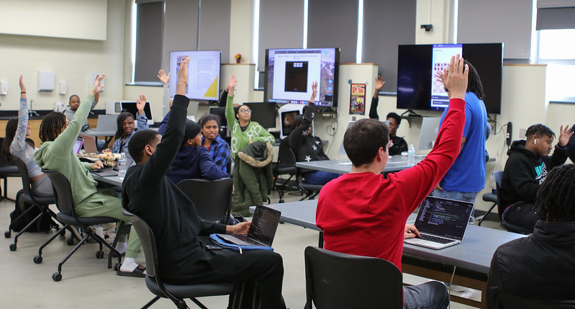
Student Expression and Assembly
Add/edit verbiage is Student Code of Conduct
Update language in two University Policies
  Policy 5902: Building Permits for Temporary Structures
  Policy 4200: University Facility Use and Cost Recovery Policy

Slide 3
Modifications to Student Code of Conduct
Violations of Laws, Regulations and Ordinances
Students are expected to abide by all University rules, regulations, and standards, and by the laws of the Commonwealth of Virginia and the federal government. Students are expected to act responsibly and to avoid conduct detrimental to themselves, their fellow students, and the University. |  | No change
The University may interim suspend any student, pending a hearing, who has been convicted of a felony that adversely reflects upon their character and fitness as a member of the student body or that negatively reflects upon the University’s mission. Felony convictions of any type, including any conviction for illegal use, possession, or distribution or intent to use, possess, or distribute controlled substances (i.e., drugs), may be cause for expulsion. |  | DELETE “that adversely reflects upon their character and fitness as a member of the student body or that negatively reflects upon the University’s mission“
Disciplinary action may be taken when a student is on property other than the University campus where such student’s conduct violates federal, state, or local laws, regulations, orders, or ordinances. |  | Add - regulations, orders, or ordinances.

Slide 4
Modifications to Student Code of Conduct
Disruptive Acts
Whenever, in the opinion of any member of the University community, a student’s or a student organization’s conduct is disorderly or disruptive, it is the responsibility of the person(s) observing the breach of conduct to report the same in writing to the Dean of Students, the University Police, the Director of Student Conduct or the Director of Student Activities. |  | No change
Section 2 – Unauthorized Activities in and on Campus Buildings Virginia State University does not authorize activities that have the potential to create excessive noise, inflict damage upon University property, or cause physical injury. |  | No change
Section 5 – Disorderly Conduct Students whose behavior disrupts the regular or normal functions of the University, including those whose behavior breaches the peace or violates the rights of others, are in violation of disorderly conduct provisions. |  | No change
5.2 Students shall comply with reasonable and lawful requests or directives by residence hall staff members or other employees acting in the performance of their official duties. This includes presenting a student-identification card or being requested to leave an area designated as off-limits. |  | No change
5.8 Unauthorized assembly, demonstrations, or acts of picketing of any kind are not permitted. All assemblies, demonstrations, and similar acts must have prior approval and be registered with the Office of Student Activities or the Office of the Vice President for Student Success and Engagement. |  | No change

Slide 5
Modifications to Student Code of Conduct
Disruptive Acts
5.13 No person may obstruct, disrupt, or attempt by physical force to cancel or discontinue speech by any speaker, or the observation of speech by any person intending to see or hear a speaker. |  | New
5.14 Other Disruptive Acts: Disrupting or obstructing the normal living and work environments of other members of the university community or the functions or activities of the university (as well as activities conducted on the university's property with its permission). Examples include: blocking entrances, corridors or exits; interfering with ongoing educational activities cultural events, or recreational, extracurricular or athletic programs; unauthorized presence in a building after normal closing hours or after notice that the building is being closed; interfering with vehicular or pedestrian traffic; creating unsanitary conditions; and interfering with any other effort to protect the health and safety of members of the university community or larger public. |  | New
Students have a continuing duty to promptly report any arrests for violations of federal, state, local, or international law, excluding minor traffic violations that do not result in injury to others. This duty applies regardless of where the arrest occurred (inside or outside the Commonwealth of Virginia) and regardless of whether the University is in session at the time of the arrest. An arrest includes the issuance of a written citation or summons regardless of whether the student is taken into custody by law enforcement. Reports should be any such arrests should be made to the Department of Student Success and Engagement (804) 524-5504 or the Office of Student Activities at (804) 524-5701. |  | Revised

Slide 6
Violations of Student Code of Conduct
“Interim suspension will be imposed for offenses that constitute a clear and present danger to the property and safety of the University and its constituents or that pose a serious detriment to the established system of discipline and decorum on the campus.”
Administrative hearing conducted 3-5 business day
  Sanction can include warning, probation, community service hours, fines, forfeiture of campus privileges, no contact, restitution, suspension from residence halls, suspension from university, and expulsion.

Slide 7
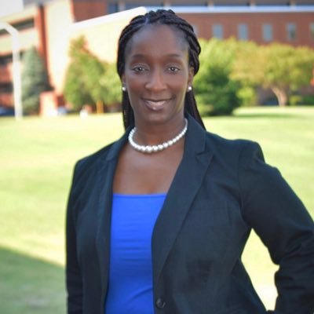
Communication of Student Code of Conduct
VSU website
Orientation
Welcome Week
Residence Hall Meetings
Student Leadership Meetings
Advisors

Slide 8
Shawri King-Casey, JD
Vice President, Institutional Integrity & Compliance

Slide 9
Policy Review Process
Current Language Considered
Incorporation
Compatibility with Other Policies
Draft Revisions/ Review
Updates Required for Changes in the Law or Landscape

Slide 10
Policy 5902: Building Permits for Temporary Structures
Purpose
The purpose of this policy is to outline procedures for the application of and approval for a building permit for any tents, canopies, stages, bleachers, or other temporary structures to be placed on university property. This policy is designed to ensure the safety of all occupants in addition to making sure all structures are properly placed and constructed in a manner that will not conflict with other university structures, activities, or utilities. This policy applies to all departments and all facilities that are owned, leased, or operated by the university. This policy requires compliance with the current editions of the Construction Professional Services Manual (CPSM), Virginia Statewide Fire Prevention Code (VSFPC), Virginia Uniform Statewide Building Code (VUSBC), and the notices issued by the Department of Engineering and Buildings (DEB Notices).

Slide 11
Policy 5902: Building Permits for Temporary Structures
Definitions – Additions
Tent - Any structure, enclosure or shelter with or without sidewalls or drops which is constructed of canvas or pliable material supported in any manner except by air or the contents it protects.
Camping - The act of using any part of the campus for living accommodation purposes, such as establishment of temporary or permanent living quarters, sleeping outdoors overnight, making preparations for overnight sleeping (including the laying down of bedding), storing personal belongings, using any tent, shelter, or similar structure regardless of size for sleeping, sleeping in, on or under parked vehicles, or setting up temporary or permanent sleeping areas outdoors or in structures not designated for human occupancy. Camping does not include: the use of university real property that has been wholly or partially designated as sleeping areas, a tailgating activity in conjunction with a university event, or the use of temporary hammocks used in recreation or studying activities outside during non-overnight hours.

Slide 12
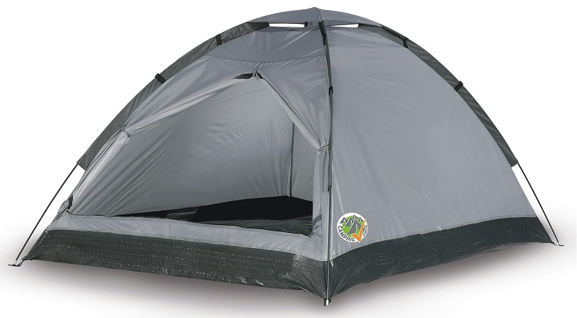
Policy 5902: Building Permits for Temporary Structures
Definitions – Additions
Camping Tent - any collapsible tent or structure, typically having as its basic components a flexible material supported by a framework, designed, intended, or used as temporary shelter while camping or on recreational outdoor outings. Camping Tents may include tents known as “pup tents,” “dome tents,” “cabin tents,” “hiker tents,” and “backpacking tents.” A Camping Tent does not include a tent with all sides entirely open and where there is an unobstructed view into such tent from the outside at all angles.

Slide 13
Policy 5902: Building Permits for Temporary Structures (Additional Language)
Constructing, occupying, or sleeping in tents or camping on university-owned or operated properties is prohibited unless approved in advance by the University.
Camping and Camping Tents are prohibited.
Even if approved, the actual construction of tents or other structures must comply with requirements to avoid disrupting or obstructing university functions, including impeding pedestrian or vehicular traffic, blocking ingress/egress, creating unsanitary conditions, limitations on amplified sound, or other specified disruptive activity. Any tents or other structures must also comply with safety requirements imposed by federal, state, and local law. If the actual use of the tents or other structures is in violation of any of these requirements, the approval will be revoked.

Slide 14
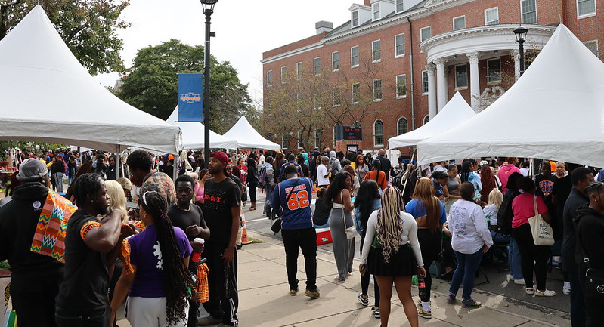
Policy 5902: Building Permits for Temporary Structures (Additional Language)
Tent approval requests should specify the time, location, and duration for which the approval is sought.
Tents constructed at or around specific athletic events where a permit or space has already been provided by the University for use at that event do not require pre-approval under this policy. However, all other requirements concerning the use of tents still applies.

Slide 15
Policy 4200: University Facility Use and Cost
Purpose
The purpose of this policy is to establish guidelines and procedures for the use of and recovery of costs for University facilities. The facilities of the University exist for the primary purpose of assisting the University in fulfilling the University's educational mission. The University seeks to enrich members of the University community through its academic, cultural, and athletic programs and events. Furthermore, the University is committed to being an integral part of our surrounding community. Accordingly, the University's resources are to be used by students, faculty and staff and, when appropriate, sponsored groups and organizations not affiliated with the University. The University reserves the right to deny the use of its facilities to any individual or group whose planned activity or event does not enhance the University's educational mission, or whose planned activity or event poses unusual or potentially costly problems. Furthermore, the University reserves the right to cancel or reschedule a scheduled event when it conflicts with University affairs or events sponsored by the University.

Slide 16
Policy 4200: University Facility Use and Cost
Usage Rules (Additional Language)
All events must have an institution-affiliated sponsor. The sponsor must have someone onsite or immediately available throughout the event. Non-university groups or organizations must have a university sponsor to hold an event. A contractual agreement for hosting an event (between a university entity and an external individual, group or organization) is considered a form of sponsorship for the purpose of this Policy.
Certain locations are altogether prohibited from usage for events, including residence halls, administrative buildings, and academic buildings during class time.
An advance reservation process is required for identified locations and such reservation includes an agreement to follow University facility use rules and to not violate state law. The person or entity making such reservation acknowledges these obligations and agrees to comply.
Groups and individuals participating in the activities, whether sponsored or not, are accountable for compliance with the provisions of this policy. Violations of this policy may be grounds for disciplinary action. Individuals or groups who invite non-University participants may be held accountable for such participants' compliance with this policy.
No illegal activity is permitted at events.
Event participants cannot obstruct vehicular or pedestrian traffic and cannot block ingress or egress to facilities

Slide 17


Slide 18
Alexis Brooks-Walter
Vice President of Student Affairs and Enrollment Management

Slide 19
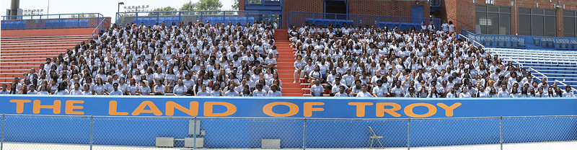
Fall 2024 Admission Update
 | Fall 2022 | Fall 2023 | Fall 2024
Undergraduate (Freshmen)
Applications | 13,722 | 25,684 | 26,813
Admits | 7,511 | 9,461 | 10,734
Deposits | 1,533 | 1,688 | 1,790
Transfer
Applications | 1,243 | 1,497 | 1,593
Admits | 509 | 441 | 589
Deposits | 291 | 282 | 347

Slide 20
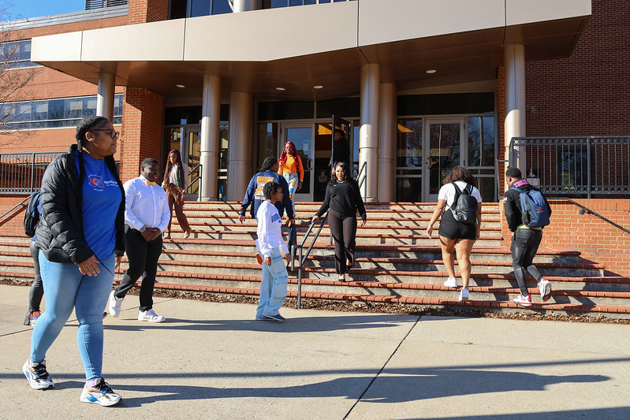
Fall 2024 Admission (Graduate)
 | Fall 2022 | Fall 2023 | Fall 2024
Graduate
Applications | 754 | 1,076 | 1,668
Registered | 190 | 283 | 409

Slide 21
Fall 2024 Enrollment (Paid/Validated)
 | Fall 2022 | Fall 2023 | Fall 2024
Student Type
Continuing Education | 9 | 43 | 29
Doctoral | 52 | 51 | 61
Graduate | 245 | 238 | 306
Undergraduate | 4133 | 4139 | 4247
Total | 4439 | 4471 | 4643

Slide 22
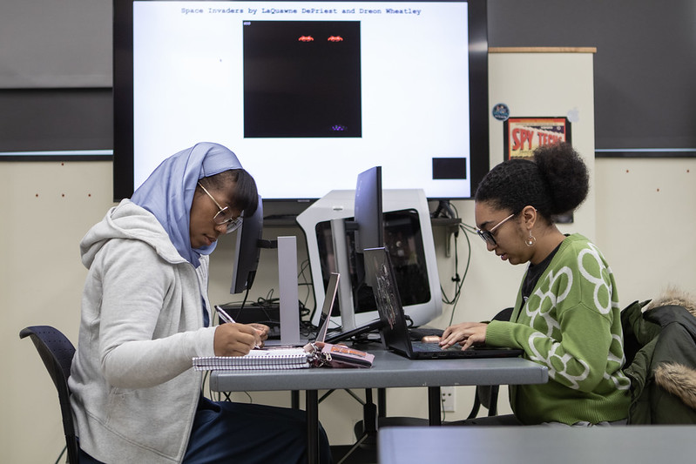
Fall 2024 Enrollment Projections as of September 3rd
 | Registered | Paid | Final Headcount
Fall 2021 | 4441 | 3512 | 4300
Fall 2022 | 4934 | 4489 | 4648
Fall 2023 | 5469 | 4471 | 5190
Fall 2024 | 5800 | 4643 | 5311 | 5557

Slide 23

2024 Housing Updates
 | Capacity | Filled | Vacancy
On campus | 3250 | 3214 | 36
UAE | 475 | 473 | 2
Apartments/RBC | 244 | 226 | 18
TOTAL | 3969 | 3913 | 56

Slide 24
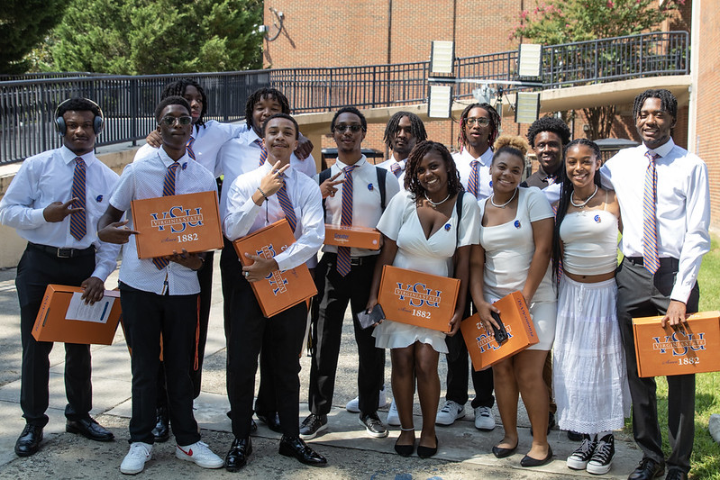
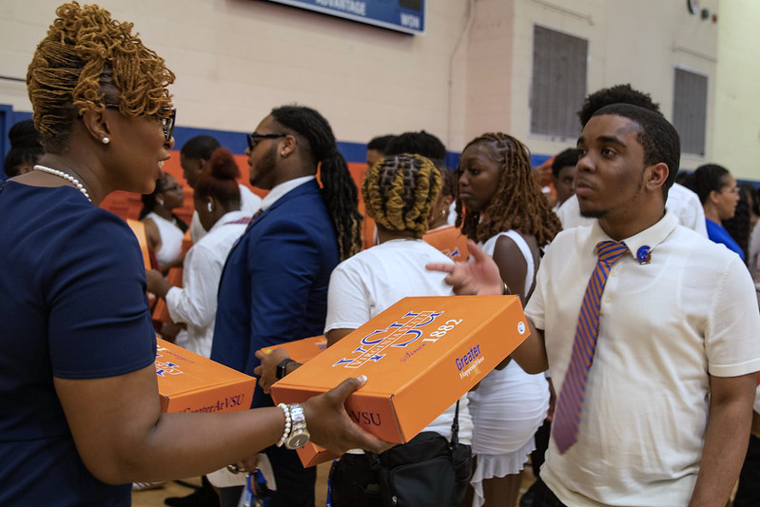
Enrollment Management/ Student Engagement

Slide 25
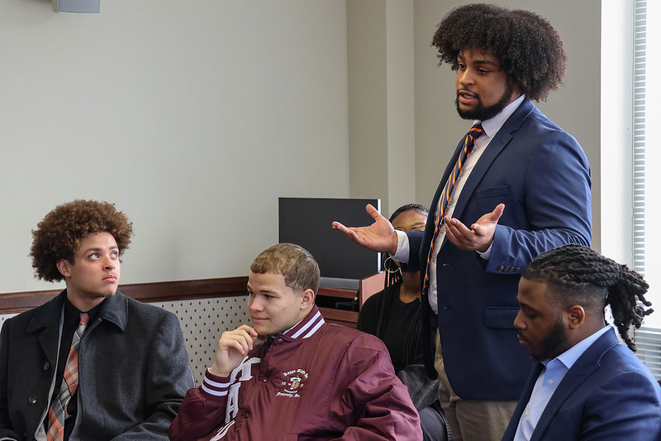


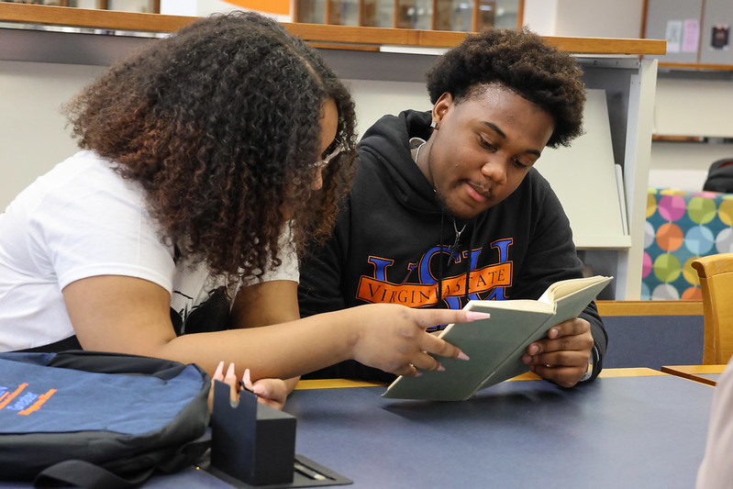

Slide 26
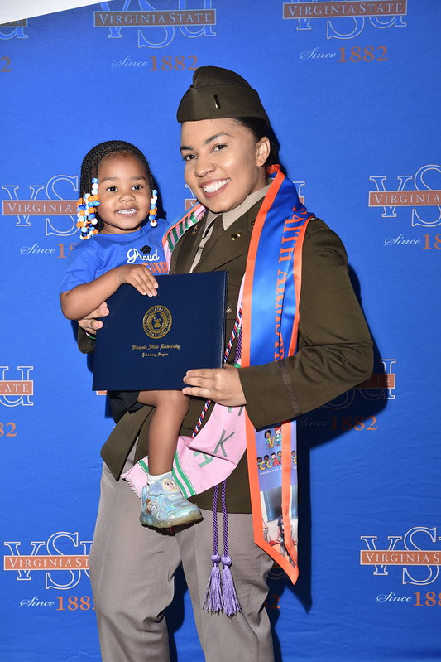
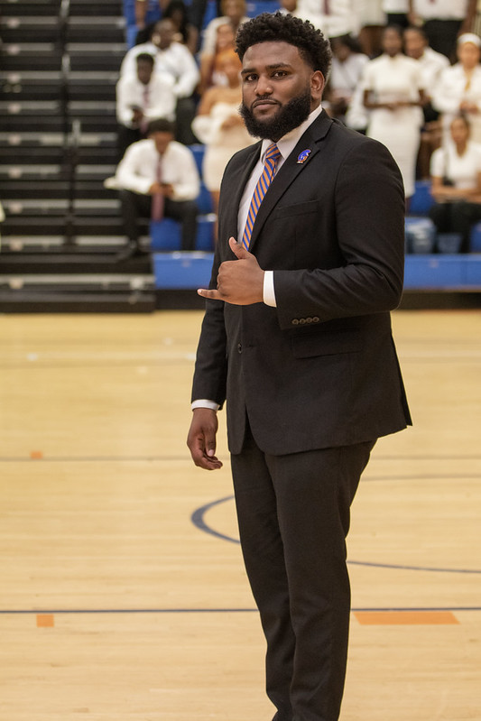


Slide 28

VIRGINIA STATE UNIVERSITY
BOARD OF VISITORS
VSU POLICE DEPARTMENT
David L. Bragg
AVP for Public Safety/Chief of Police

Slide 29

Campus Crime Report
2023 – 2024 YTD (Jan – Aug)
Offense | 2023 Jan - Aug | 2024 Jan - Aug
Homicide | 0 | 0
Sex Offenses | 0 | 5
Robbery | 2 | 0
Aggravated Assault | 2 | 7
Burglary | 9 | 3
Auto Theft | 2 | 1
Arson | 0 | 0
Domestic Violence | 0 | 2
Dating Violence | 17 | 13
Stalking | 2 | 1
Total | 34 | 32

Slide 30
Campus Arrest Report YTD 2024
Campus Arrest Report | Jan | Feb | Mar | April | May | June | July | Aug | Totals
Weapons Law Violations | 1 | 0 | 0 | 0 | 1 | 0 | 0 | 3 | 5
Drug Law Violations | 2 | 2 | 1 | 3 | 0 | 0 | 0 | 0 | 8
Liquor Law Violations | 1 | 1 | 1 | 2 | 1 | 0 | 0 | 0 | 6
Totals | 4 | 3 | 2 | 5 | 2 | 0 | 0 | 3 | 19

Slide 31
Shooting Incident Update
On August 14, 2024, at approximately 12:30 a.m., while officers were assigned to provide visibility outside of Daniel’s Gym, shots were fired in the parking lot.
VSU police officers observed the incident unfolding. Officers were able to prevent further injuries by confronting several males armed with firearms. Officers arrested two males and detained one male during this incident. None of the suspects were enrolled at VSU.
Officers then discovered two adult males and two adult females with non-life-threatening injuries and are recovering. None of the victims were enrolled at VSU.
Chesterfield County Police and VSU Police Departments are continuing to investigate this incident.

Slide 32
We learned that the suspects parked their vehicles in Petersburg by the Appomattox River. This information came from the police interrogation of the suspects. The suspects stated that students invited them to attend the event. The non-students then entered campus and gained access through open areas near the south and west sides of campus. To help police identify VSU students during events, they are now required to wear wristbands or show their student IDs.
VSU will use the Capital Outlay Funds for improvements on campus by expanding the gates/fencing around the south entrance and the west side of campus. We will also have VSUPD begin wearing police reflective safety vests for more visibility. VSU Police will continue to place additional lighting during events.
VSUPD will continue to have safety meetings with Student Activities, RAs, Dorm Residential Directors, and students. We will also utilize the VSU police drone teams. In addition, the university has also included in the Capital Outlay Project the purchase of other properties around the area, including the corner store at Boisseau St. and Chesterfield Ave.

Slide 33
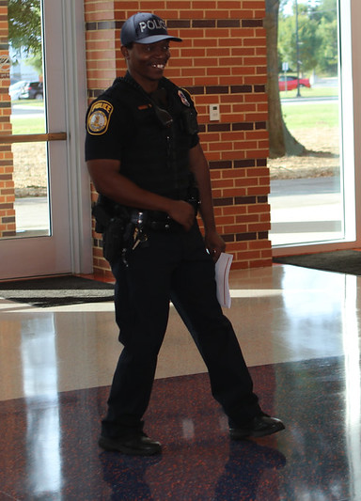
Safety Measures on Campus
VSU police officers are assigned stationary posts outside several residence halls/UAE overnight.
RMC Security is assigned to stationary posts at every dorm.
Mobilization of portable camera towers in areas of concern.
Light towers are deployed in low-light areas.
Deterrent vehicles are placed in areas around campus.
The utilization of speed trailers throughout campus.
R.A.D Training for students, faculty, and staff.

Slide 34

Training
Officers attended active shooter training at Bear Swamp Tactical School
Officers attended annual training with Chesterfield County Commonwealth’s Attorney Office
Security Officers attended the annual security officer training hosted by DCJS

Slide 35

Thank you for your time and support!
Any Questions?
David Bragg
AVP for Public Safety/Chief of Police

