Slide 1

Virginia State University
Board of Visitors
Audit & Compliance Committee
Shawri King-Casey VP, Institutional Integrity & Compliance
Nannette Williams, Chief Audit Executive
November 14, 2024

Slide 2


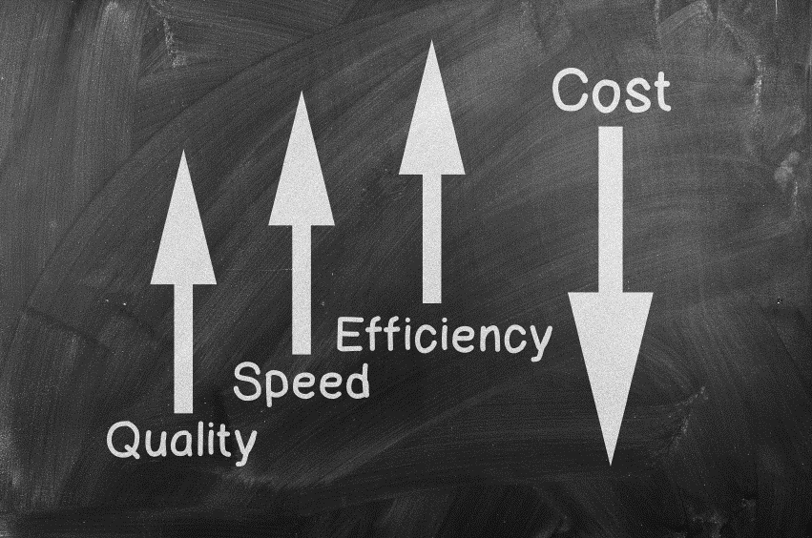
Great Progress Made, Greater Progress Maintained: A Snapshot of VSU’s Audit & Compliance Efforts
VSU Priority 5:
Diversify Financial Resources and Enhance Operational Effectiveness

Slide 3
Auditor of Public Accounts FY2023
Report
  No Material Weaknesses
  5 Significant Deficiencies Identified
  3 Repeats (1 partial)
  2 New Findings
Notes:
Brief overview of the FY 23 report, only received 2 new findings

Slide 4
Auditor of Public Accounts FY2023
Report
      Engage and Use ECOS to Provide Required Active Oversight (New)
      Improve Router Security (New)
      Improve Access & Account
      Management Controls (Repeat)
      Improve Financial Reporting Review Process (Repeat)
      Improve Service Provider Oversight (Repeat)

Slide 5

Auditor of Public Accounts FY2023
Report
    CONCURRENCE vs. NON-CONCURRENCE
    CORRECTIVE ACTION UNDERWAY
    LOOKING AHEAD

Slide 6

Internal Audit Update

Slide 7

Internal Audit Update Agenda
I. Audit Status/Progress since last meeting
Small Purchase Charge Card Audit
Closed Session

Slide 8
Where are we now?
Our Internal Quality Assessment Review is complete and we are compiling the areas for improvement and implementing corrective action where necessary. Our assessment will be used by the external validator in completing our full QAR.
We have started an audit of the Travel Charge Card Program and anticipate issuing a report in January
The Capital Outlay audit2, which was put on hold due to staffing issues and the internal QAR, will resume this month.

Slide 9
Small Purchase Charge Card Program Audit

Slide 10
Small Purchase Charge Card Program Audit
  Overview:
    The Small Purchase Charge Card Program (SPCC) and Gold Card programs allow for individuals to purchase authorized lower dollar items. The purpose is to streamline purchasing and facilitate electronic commerce.
    The program is subject to the limits of the Procurement Act as administered by the Department of General Services, and Commonwealth Accounting and Procedures, as defined by the Department of Accounts.

Slide 11
SPCC Observations
Reconciliations and Supervisor Approvals were not always completed timely Risk Rating: Med
  Why is this important?
    Accounts Payable must pay the cards by the due date, regardless of sign off or approval. Without proper review and authorization of transactions, VSU runs the risk of paying for unauthorized or unallowable items, which could include personal purchases.
Untimely Card Cancellations Risk Rating: Med
  Why is this important:
    Separated employees have the ability to continue to use the card after leaving employment and the University is responsible for payment. We may not be able to recoup unallowable charges if the employee has received their final paycheck.
    NOTE: This is not within Procurement’s control – this was the result of untimely notification to Procurement during the separation process

Slide 12
SPCC Audit Findings
Lack of eVA Confirming Orders Risk Rating: Med
  eVA is the Commonwealth’s electronic procurement system
  Why is this important?
    Since eVA is the Commonwealth’s Procurement system of record, failure to enter all purchase information in eVA leads to gaps in procurement records.

Slide 13
Medicat Audit
Notes:
CLOSED SESSION

Slide 14

OSIG Cybersecurity Audit Findings
Notes:
Closed session - brief overview of the identified weaknesses found through the Virginia Office of Inspector General’s pentesting exercises

Slide 15
QUESTIONS?

