Slide 1

External Relations and Fall 2025
Advancement Update
Board of Visitors Meeting
February 5, 2026

Slide 2

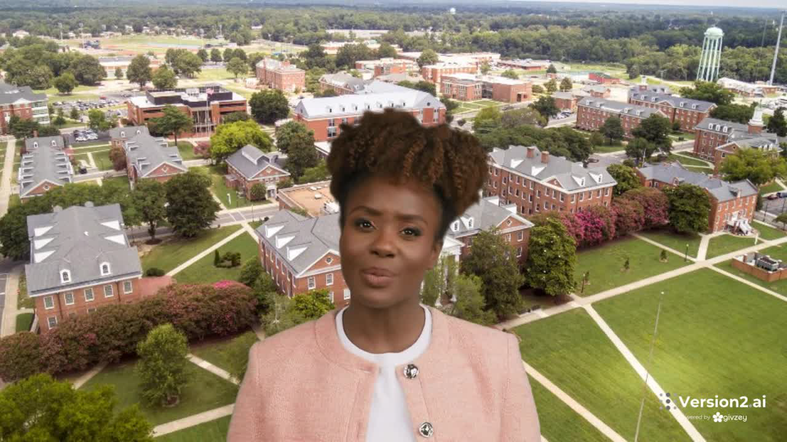
Vanessa S. Upshaw Update
92% of my portfolio has received at least 4 or more touchpoints.
The donors in her portfolio have given $59,011.34 so far this fiscal year
Her portfolio has 997 constituents.
“This fiscal Year Overview giving includes both gifts I have influenced, as well as those made prior to assignment in my portfolio”

Slide 3
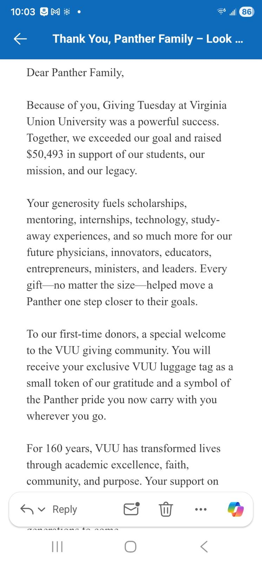
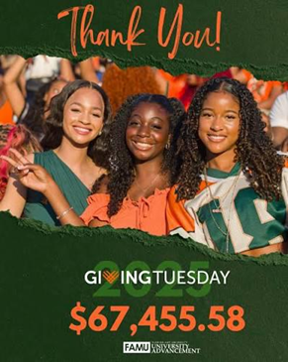

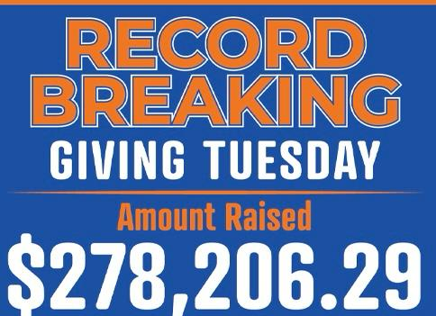
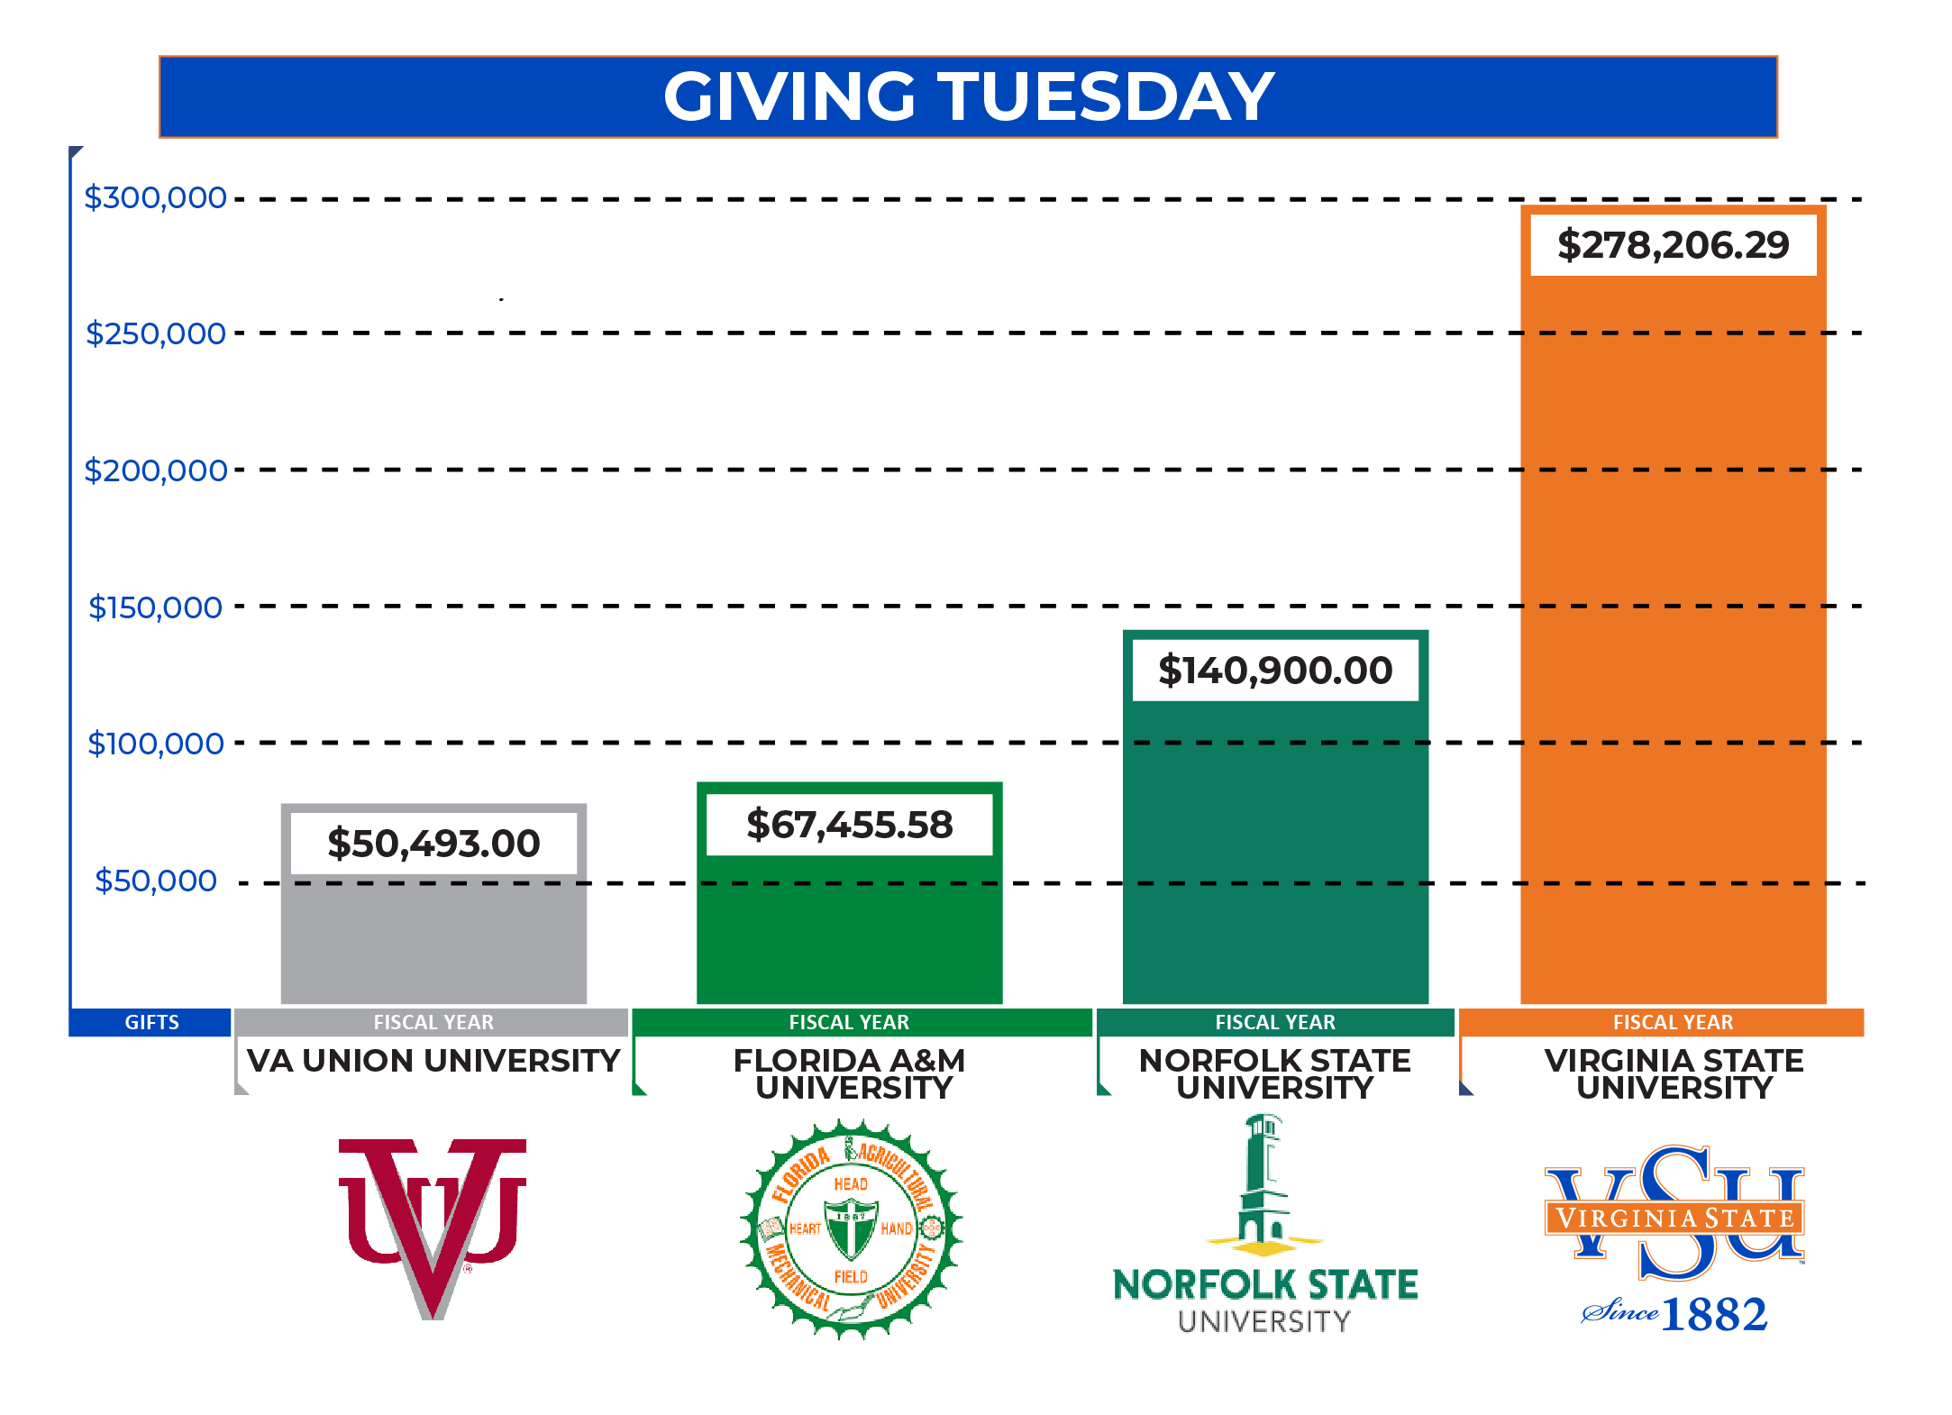
Fall 2025 Update
Funds raised (Fall 2025) compared to Fall 2024
  17 Donors who gave $25,000 or more FY26 through January 24, 2026 (3 more than FY25)
  1,859 Donor count comparison between FY26 and FY25 (225 more than FY25)
  $1,008,333 in Alumni Giving (almost $200K more than FY25)
  Giving Tuesday Total $278,206.29

Slide 4
Fall 2025 Update
 | FY 2026 |  | FY 2025 |  | FY Differences
 | DOLLARS | DONORS | DOLLARS | DONORS | DOLLARS | DONORS
Grand Total | $2,769,016.79 | 1,859 | $3,139,580.17 | 1,684 | -$370,563.38 | 175
GRAY BAR | GRAY BAR |  | GRAY BAR | GRAY BAR | GRAY BAR | GRAY BAR
ALUMNI | $1,088,333.00 | 1,274 | $886,562.94 | 1,095 | $201,770.06 | 179
ALUMNI ASSOC | $80,008.00 | 10 | $29,343.00 | 8 | $50,665.00 | 2
CORP/FDN/ORG | $1,310,543.50 | 82 | $1,897,536.04 | 105 | -$586,992.54 | -23
FACULTY & STAFF | $85,653.52 | 101 | $49,759.17 | 63 | $35,894.35 | 38
FRIENDS/INDVLS | $201,204.45 | 371 | $270,559.02 | 385 | -$69,354.57 | -14
PARENTS | $2,595.00 | 13 | $2,800.00 | 11 | -$205.00 | 2
STUDENTS | $479.32 | 7 | $3,020.00 | 17 | -$2,540.68 | -10

Slide 5





$75K Community Foundation
$200K collaboration with Bank of America Charitable Trust Foundation for Community Outreach
$215K Cameron Foundation for K-6 Student Engagement
$500K Southern Company Foundation for an Agriculture Endowed Chair
$1 M Lilly Endowment/TMCF for AI

Slide 6



New and Renewed Partnerships
$1.99M

Slide 7

CIAA Basketball Tournament

Slide 8

President’s 10th Anniversary
Scholarship Gala

Slide 9
Comprehensive Campaign Update
2021-2023
Planning Phase
$30 M
2023-2025
Quiet Phase
$40 M
2025-2026
Completion
&
Follow-up
2027-2028
2026-2027
Kick-off
$106 M
Public Phase
$______
Goal: $125M

Slide 10



