Slide 1
Board of Visitors Report February 8, 2024

Slide 2
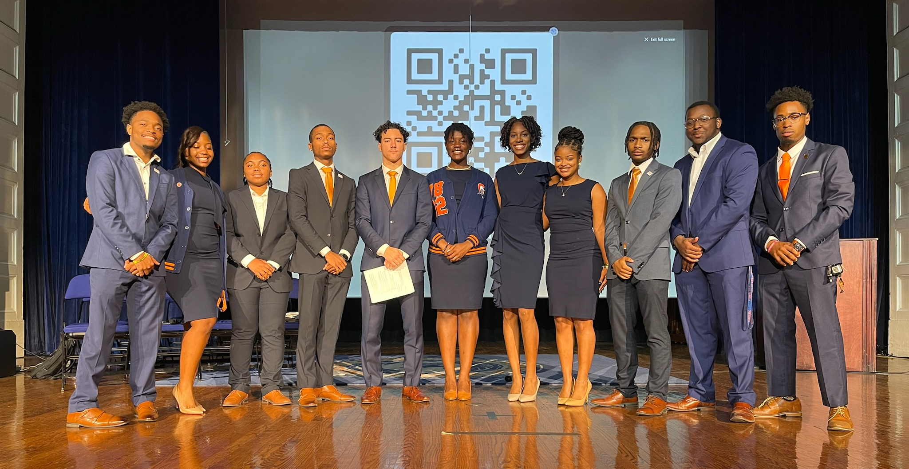
The Visionary Administration of the
Student Government Association

Slide 3
Goals-Mission-Values
Motto: We are the Vision Come to Fruition
Mission: To have VSU undergraduate and graduate students complete their degree(s) fully prepares them for their life and career; having applicable skills, lessons, and experiences to propel them into the professional, academic, and social arena of life.
Brand: Servant Student Leadership. We are not above or below anyone. Change is achieved through advocacy and pressure.

Slide 4
Spring 2024 Semester Overview
The campus is alive again as all Trojans are back on the Hill. Spring semester classes and activities are in full force. Students are acclimating back to campus and new/transfer students are learning the VSU culture, family, and traditions. The Spring Anti-Hazing leadership training and Interest meetings for respective organizations has proceeded. Black 82, VSU’s celebration of Black History and culture is here and we are ecstatic to dive in. Many leaders, students, and staff are looking forward to the CIAA conference career fair and basketball games in Baltimore, Maryland later this month.

Slide 5
What is the SGA doing now (January-February)
Attended and participated in the VSU Leadership talk for all student leaders on January 17, 2024 with guest speaker Jarrod D. Benjamin.
Participated in the “Martin Luther King, Jr. Day of Service "on January 15, 2024.
Attended and hosted, with Royal Court, VUU SGA and Royal Court at the Freedom Classic Basketball Games on January 20, 2024.
Opened a virtual student concern box for students to inform the Admin of concerns.
Hosted a Donut Decorating and Hot Chocolate with SGA mixer for students on January 30, 2024.
Several members of the Admin were inducted into the Charlie Hill Fellow Leadership Institute on January 22, 2024.
Led a Dorm Clean up on January 27, 2024 in Gateway and Moore Hall.
Hosted, led, and donated to the 4th bi-annual Blood Drive on February 1, 2024 with the American Red Cross.

Slide 6
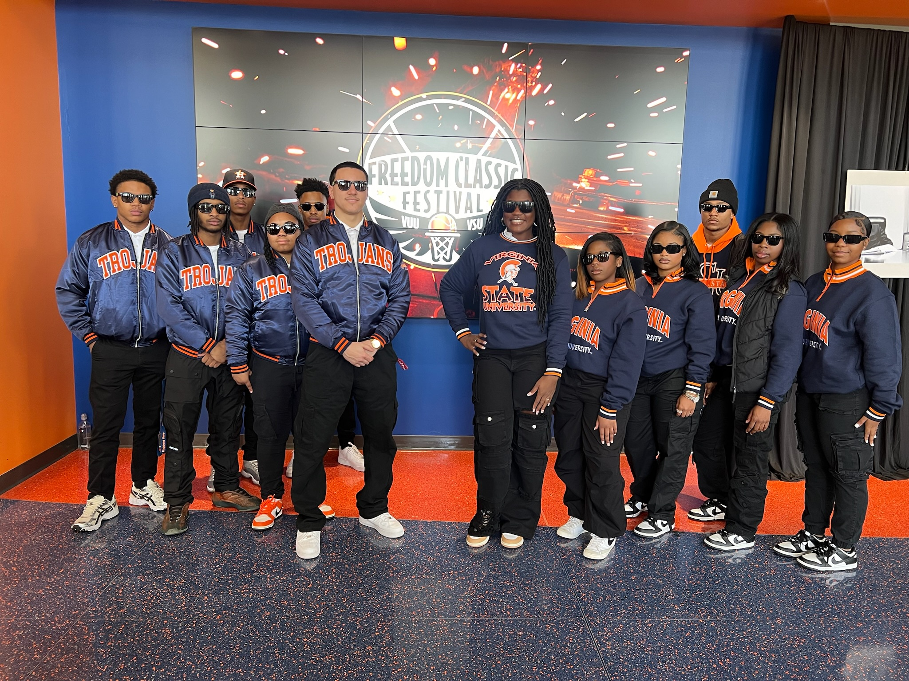
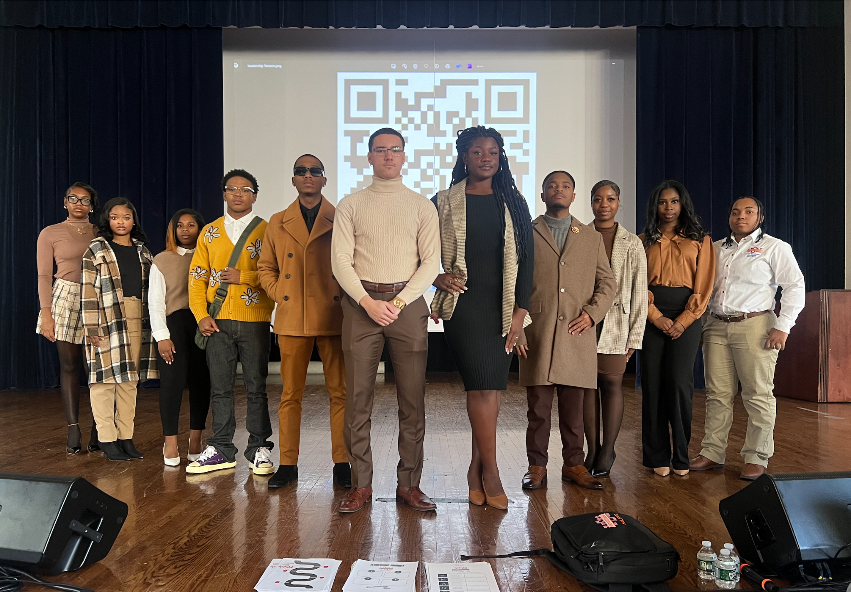
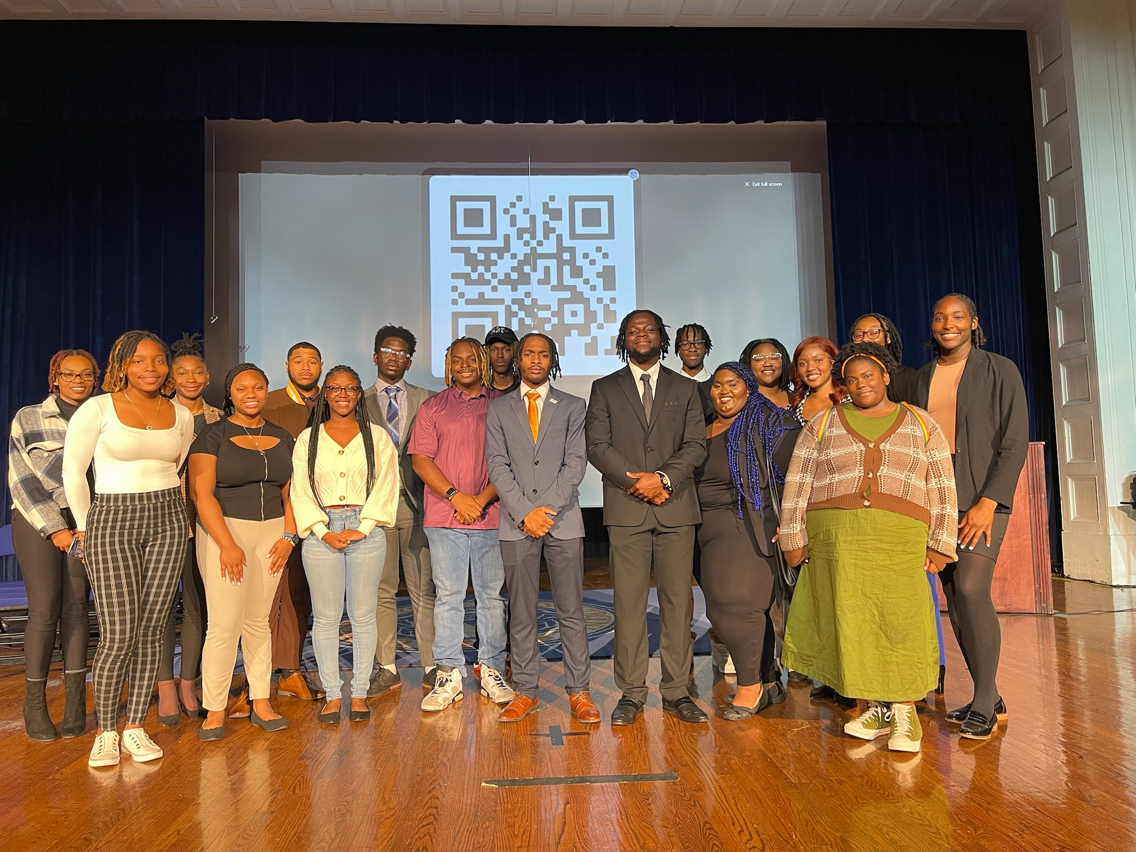
What is the SGA doing now (January-February)

Slide 7
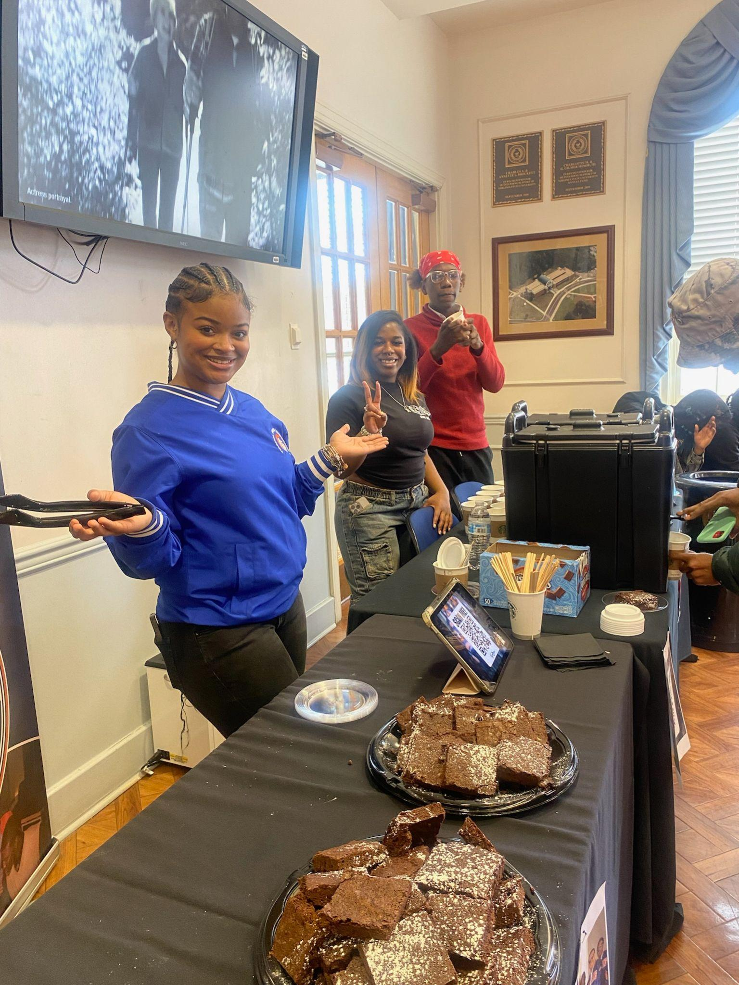
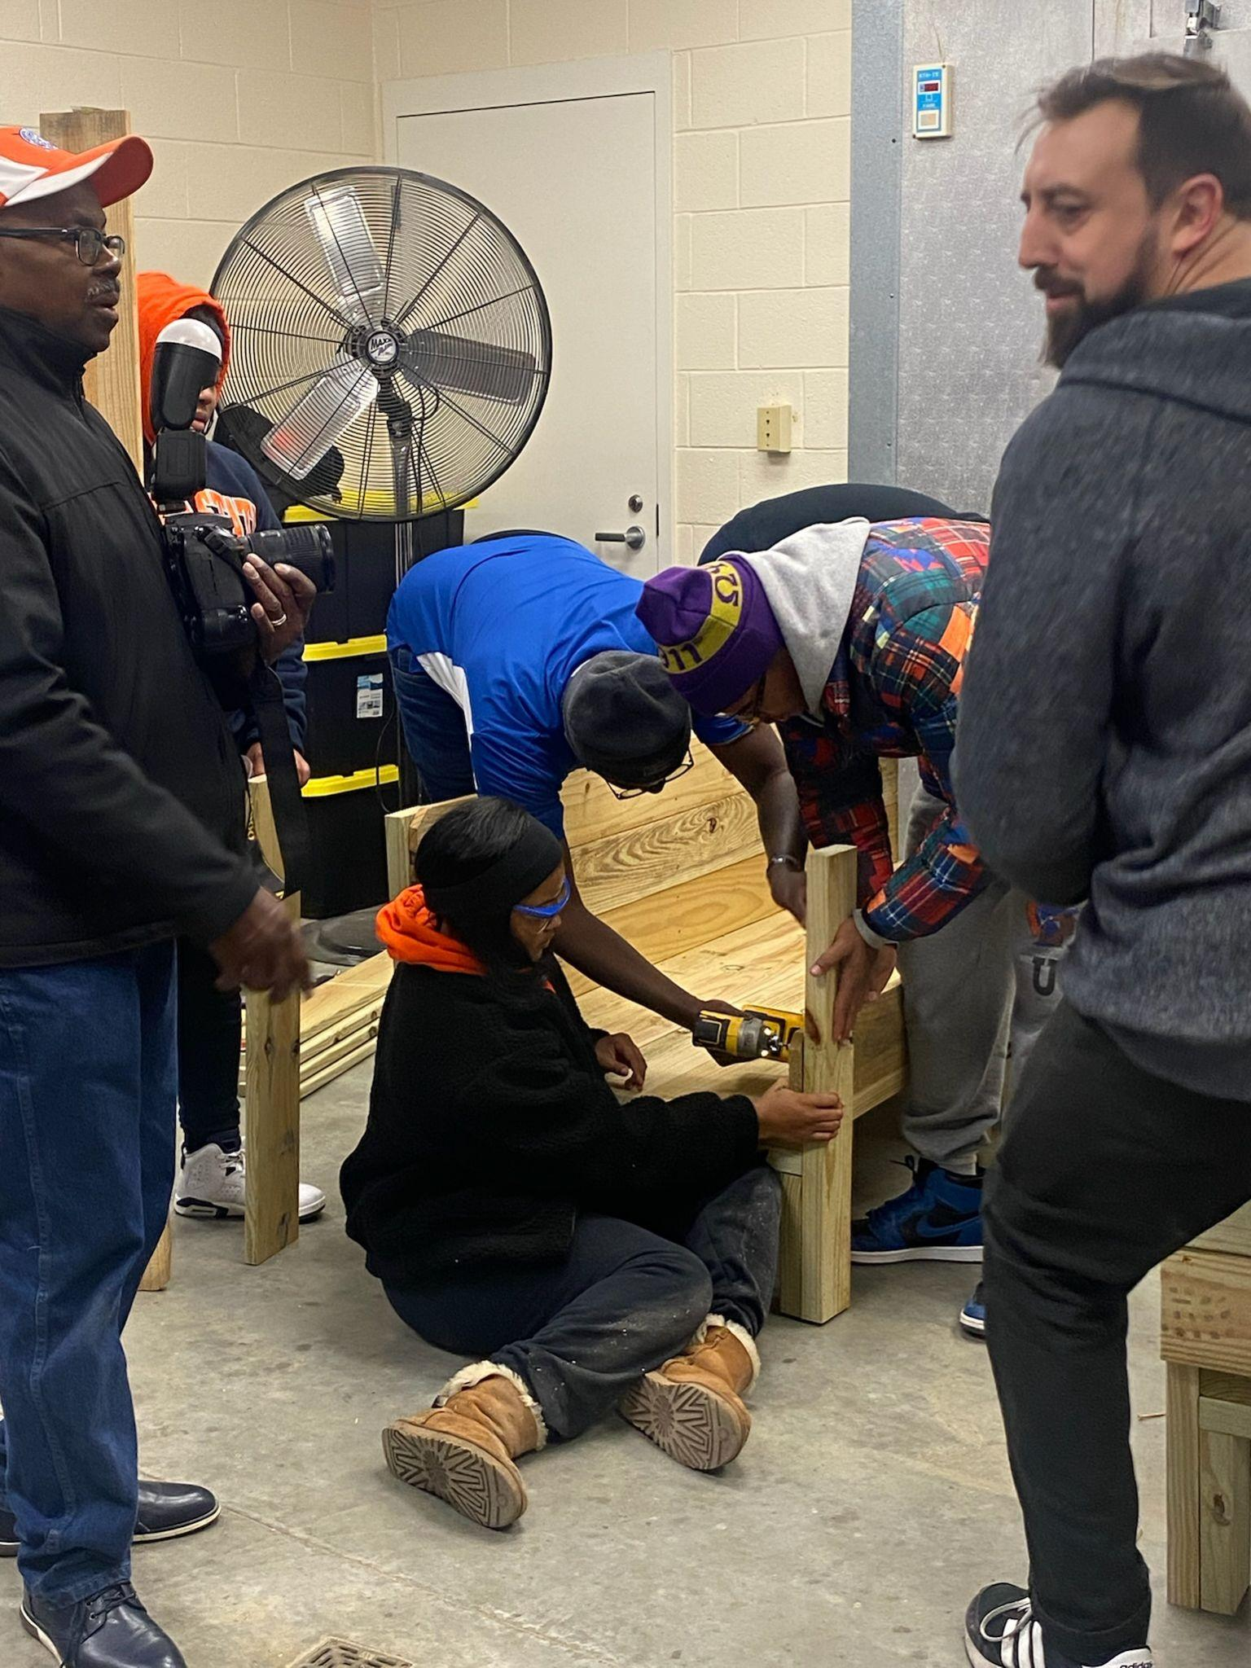
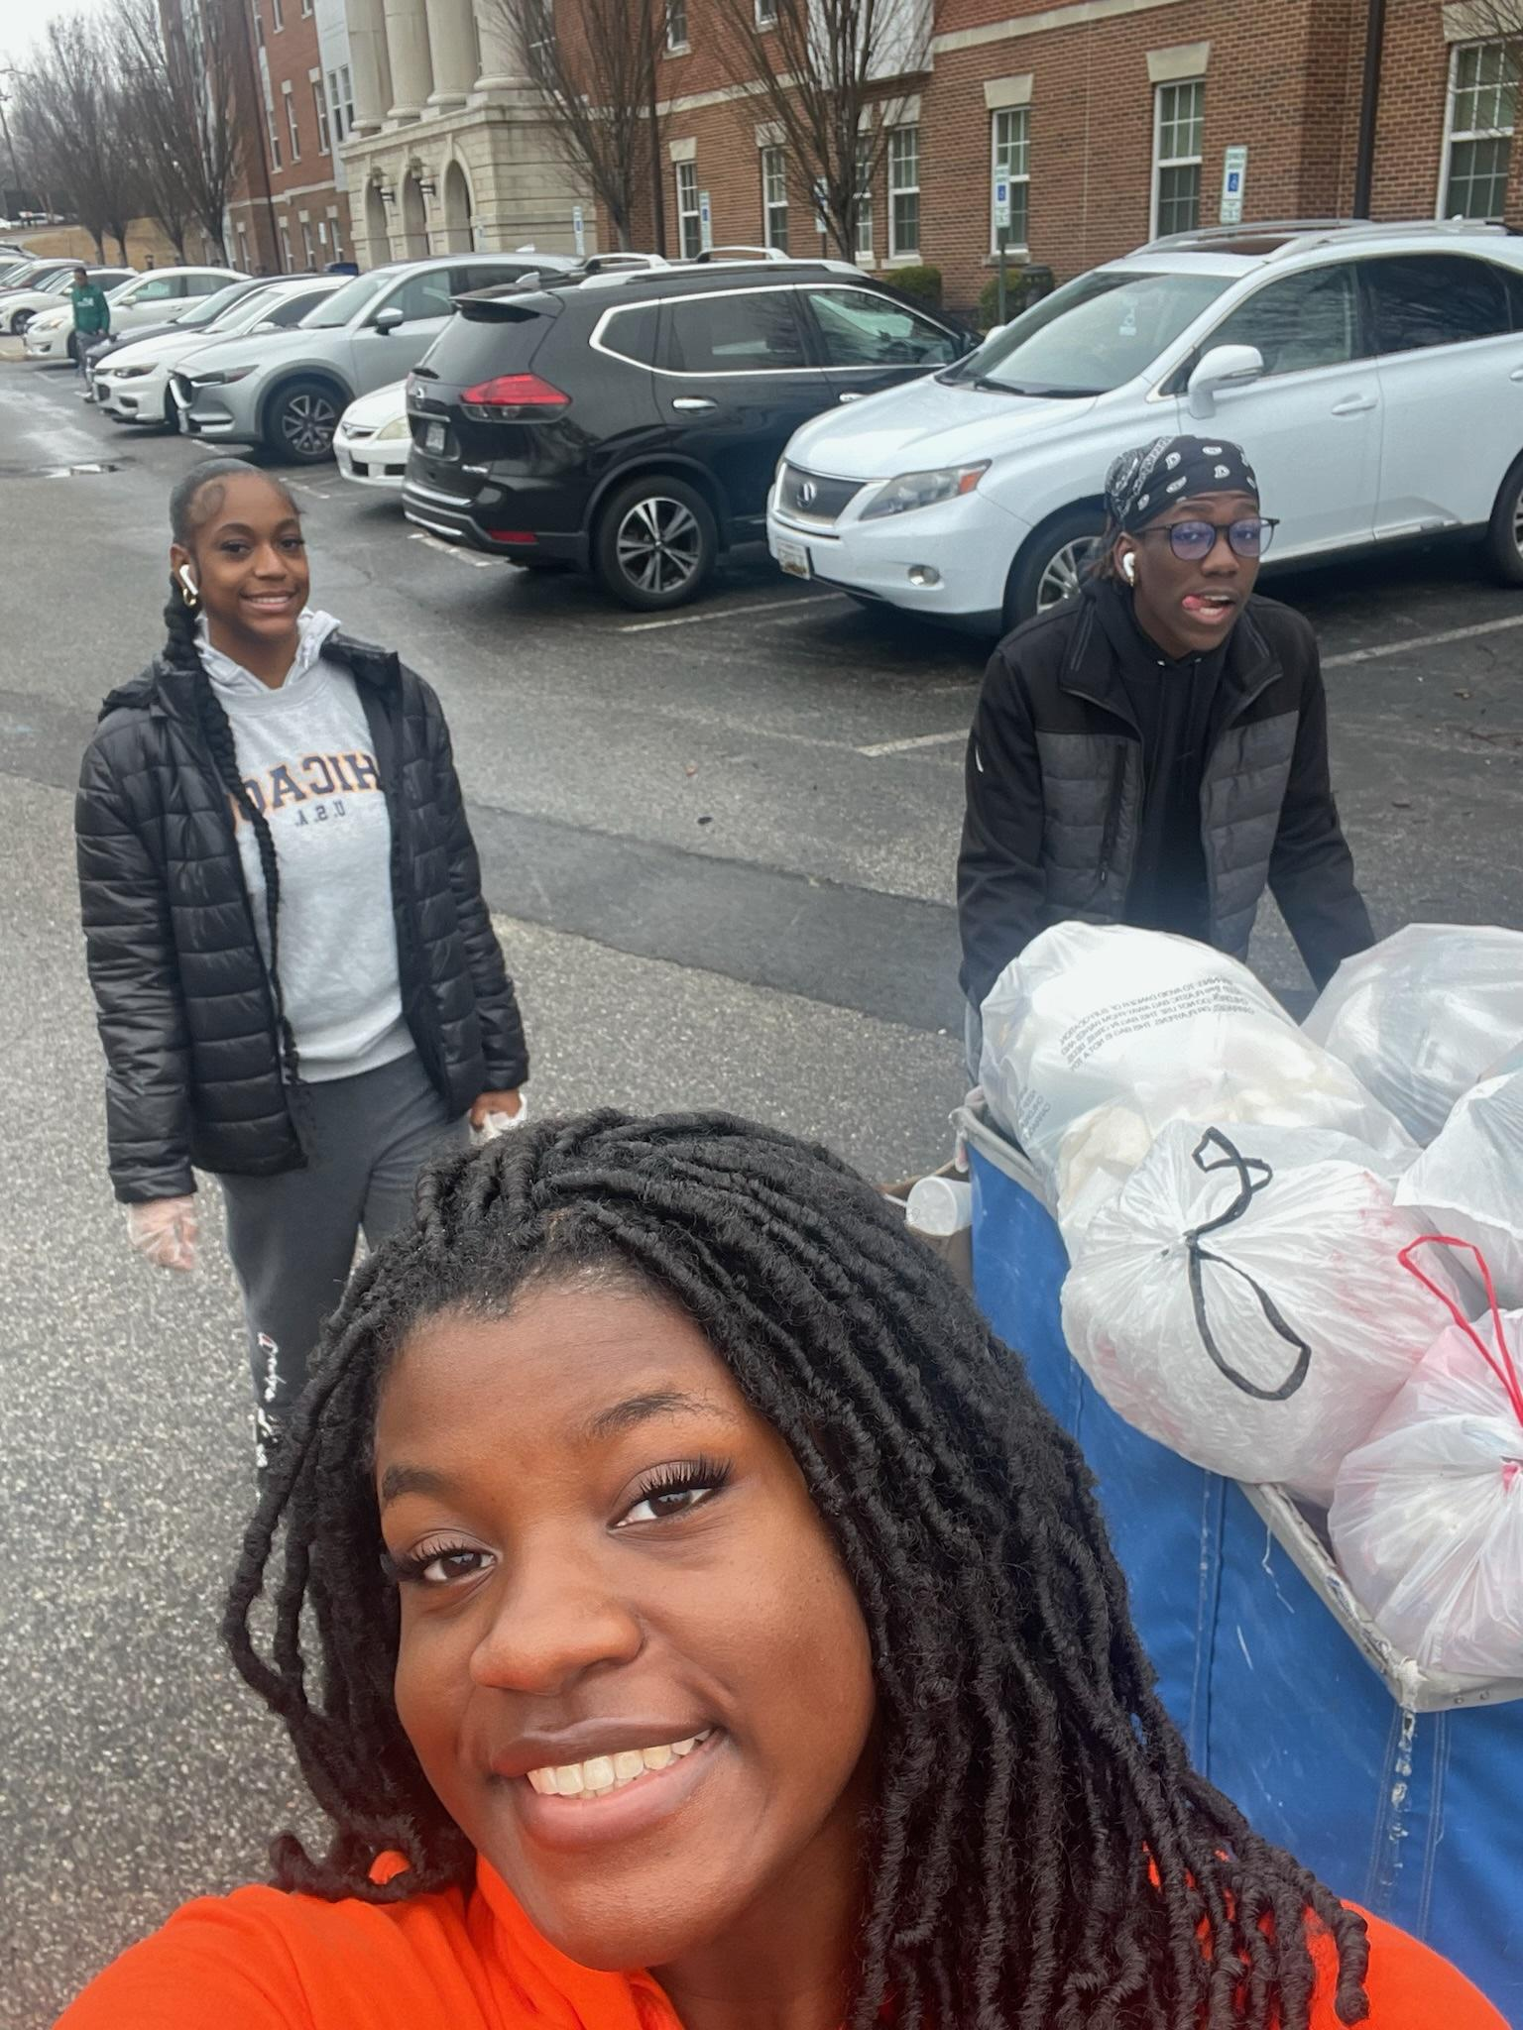
What is the SGA doing now (January-February)

Slide 8
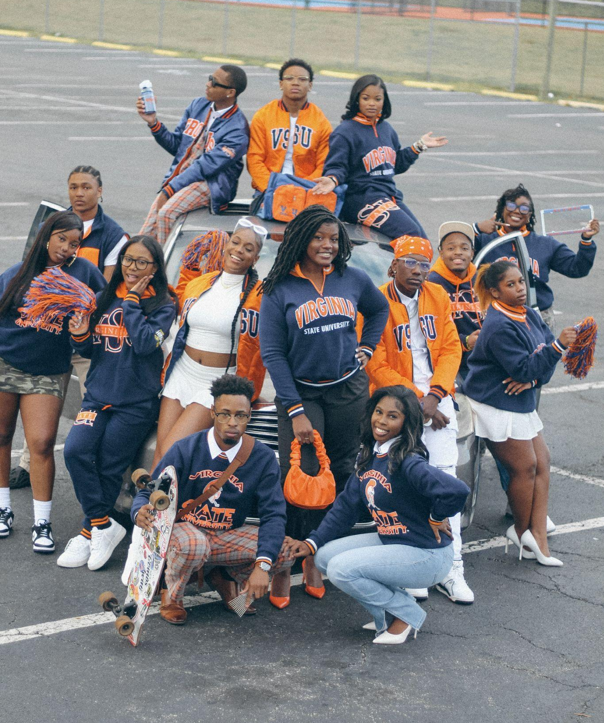
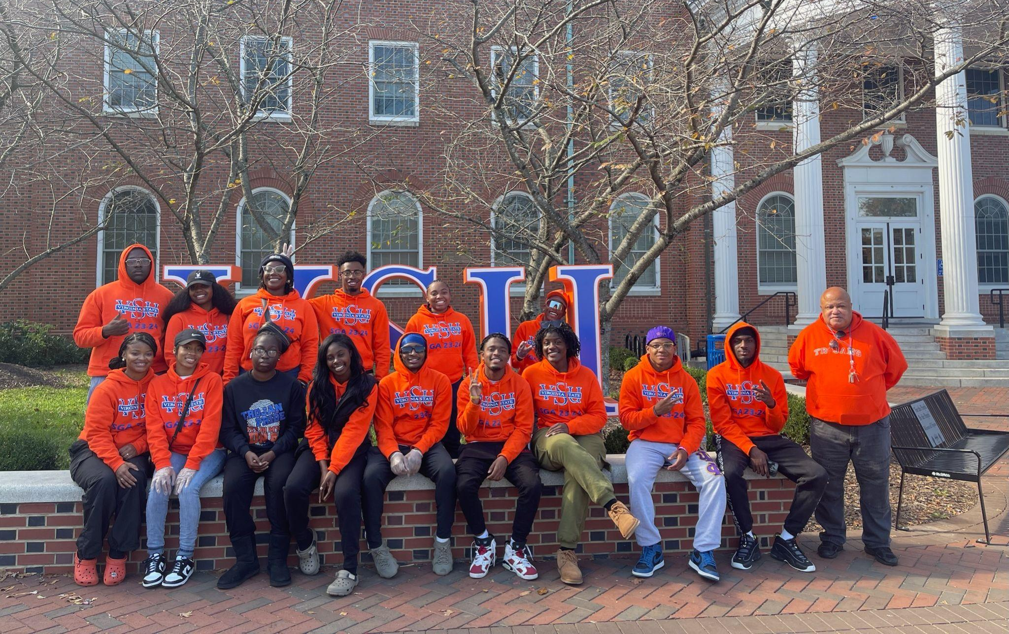

Slide 9
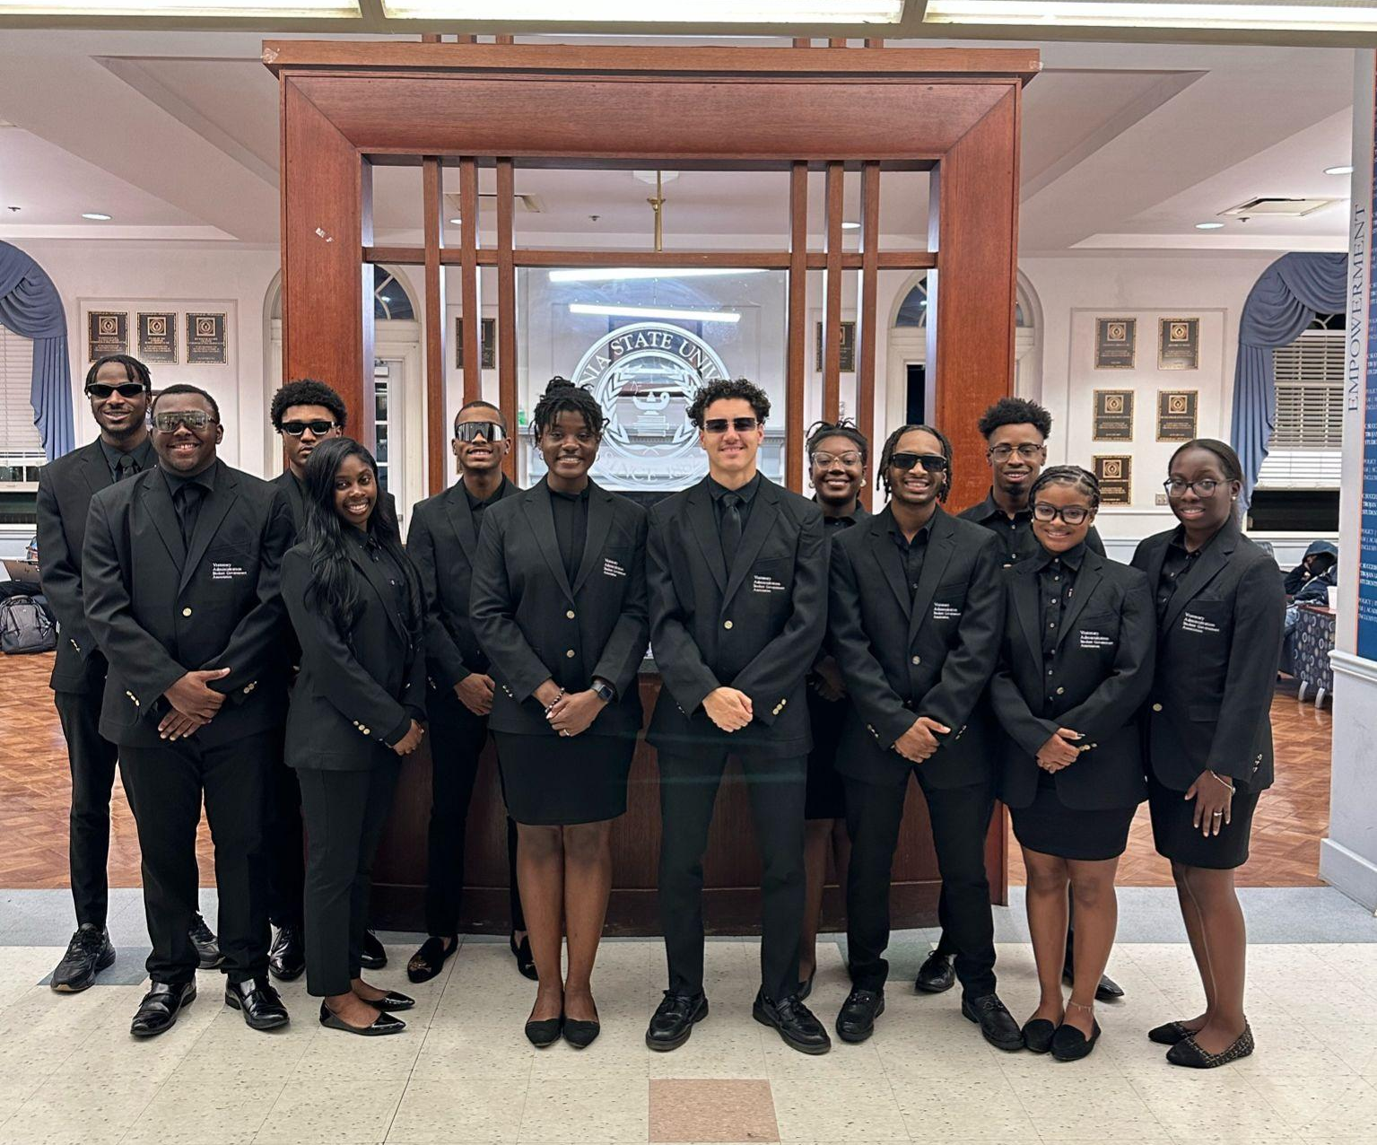
Current Initiatives
Designated pick up and drop off spot for Uber and Lyft on campus
Legacy Marker for the Visionary Administration
50 year Celebration and Legacy Formal
Trojan of the Month Award and Scholarship
Faculty and Staff Appreciation Day
Layout of a Closed Campus for VSU
Painting of Daniels Gym Parking Lot

Slide 10
Current Issues
Security cameras requested to insure safety in residence halls.
Students would like more options for shuttle transportation including South Park Mall, Walmart, Target
Wi-fi outages in Moore and Gateway and a lack of cell service for reception. Students often lack internet or cellular access in residence hall rooms-SOS signal is given. Some class buildings lack Wi-fi.

Slide 11
Questions and Dialogue

Slide 12
Thank you for your time!

