Slide 1


Board of Visitors Report
February 9, 2023

Slide 2
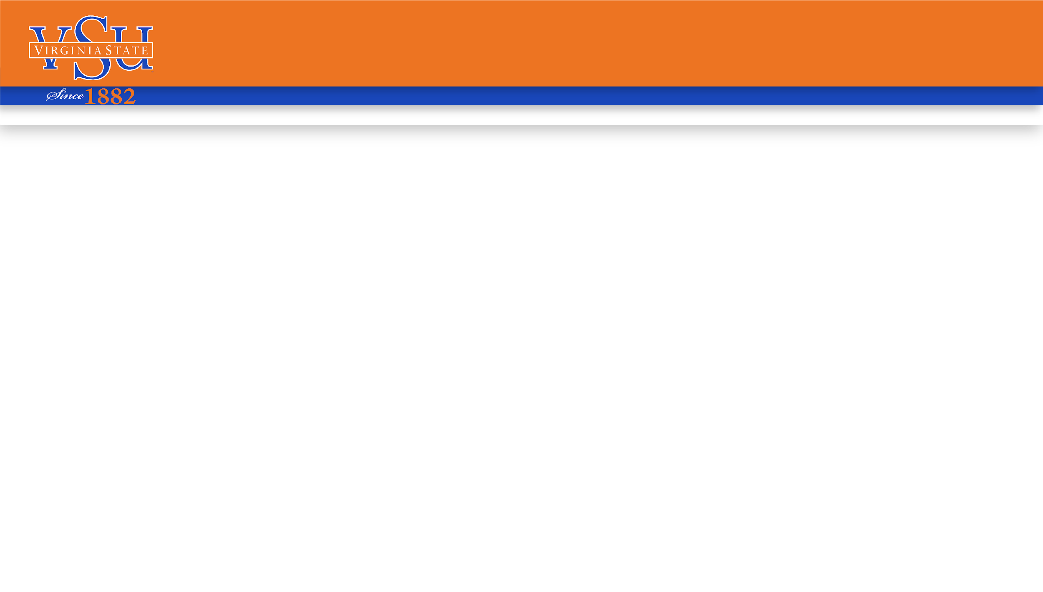
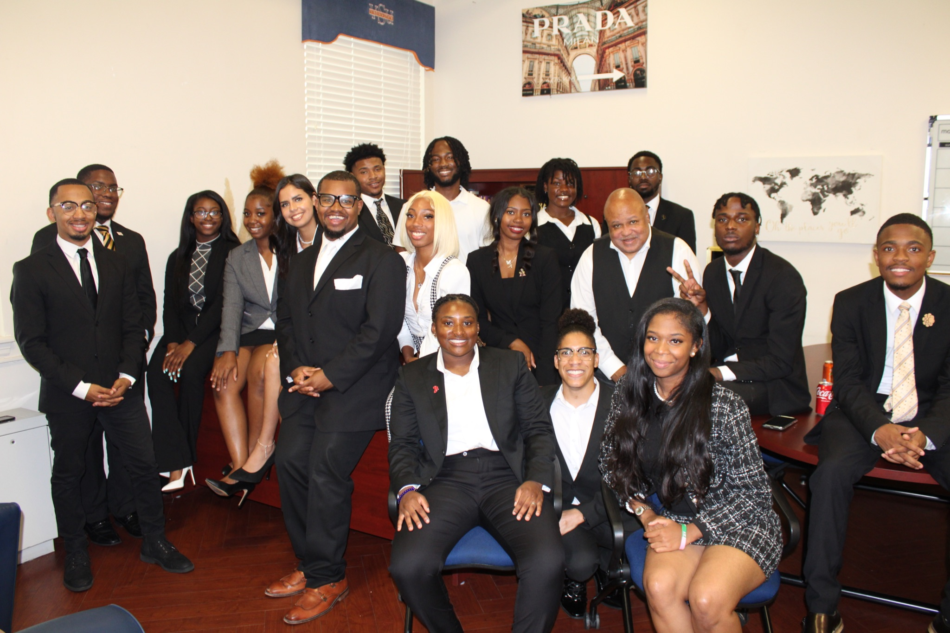
Meet The Revolutionary Administration

Slide 3

Goals-Mission-Values
Mission: “To create a long lasting legacy beyond us, leaving VSU students with tools that will prepare them for the real world and to help VSU ‘26, ‘27, ‘28 be able to thrive.”
Vision: To revolutionize, evolve, and build an empire of communication, engagement, and student success that makes it beyond the students and student body.
Values: Relatable, Accountable, Servant Leadership, Personable, Transparent, Inclusive
Slogan: “For the People by the People.”

Slide 4
Semester Overview
The campus environment at the start of the semester has been productive. Students are settled into their classes and participating in student activities. Enrollment of a large class has caused the campus to be active.

Slide 5

Previous Accomplishments
Worked with administration to provide post office hours during the weekend
Collaborated with general students in a cafe food taste test of Thompson Hospitality’s newest additions to student menu
Implemented dj in the cafe on Wednesday's at alternating cafes, Jones and Gateway
Implemented Therapy Thursday for students to better learn effective ways to care for their mental health
Implemented Fly Friday's for better engagement and outreach towards campus student population
Worked with administration to provide free laundry with app for the rest of the semester
Participated in multiple community service projects for MLK day around the Richmond and Petersburg area

Slide 6
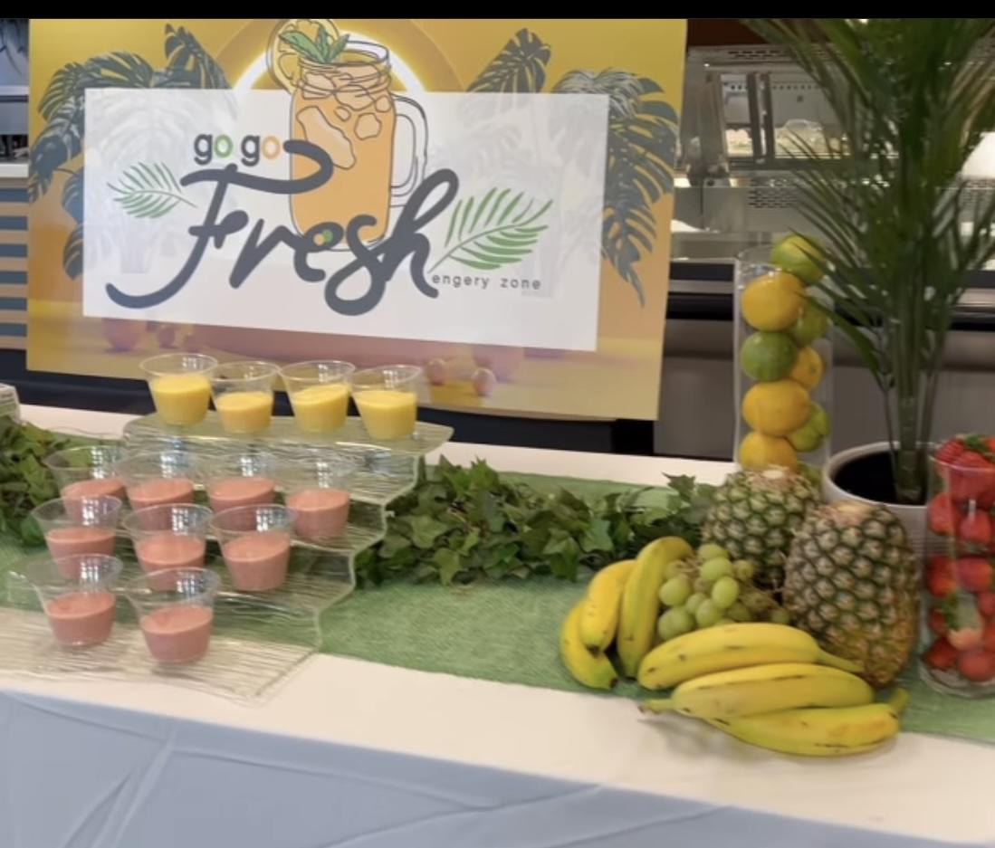
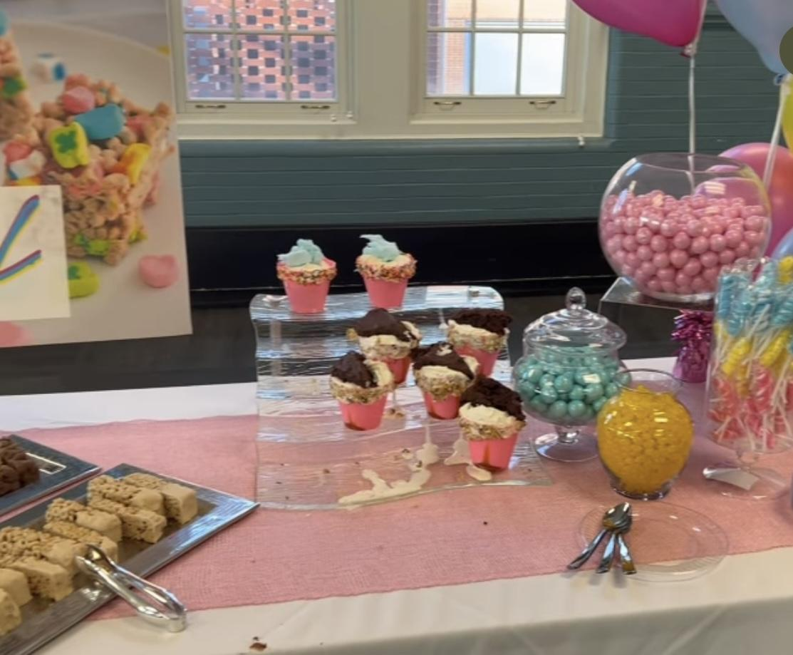

Slide 7
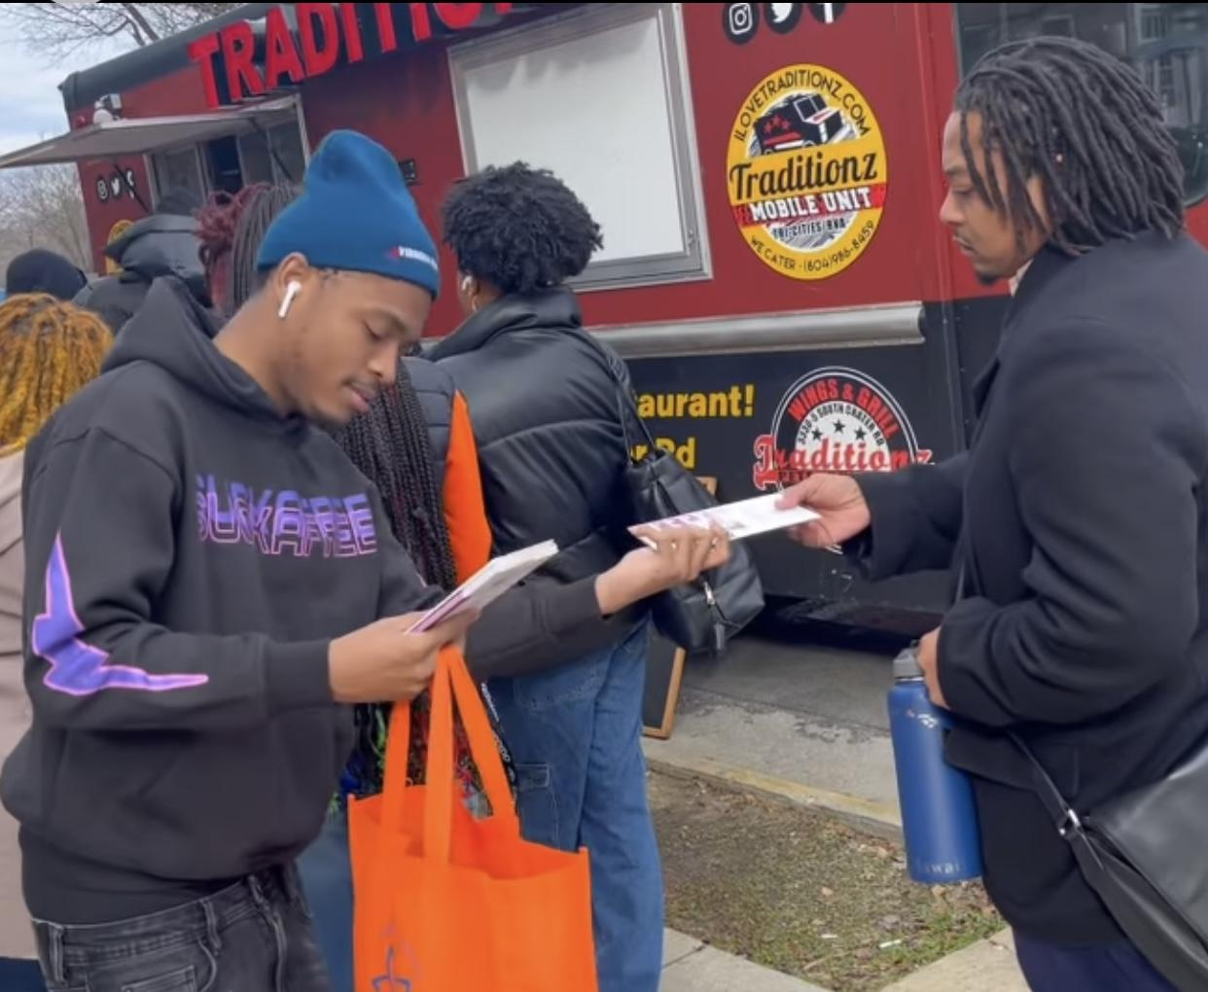
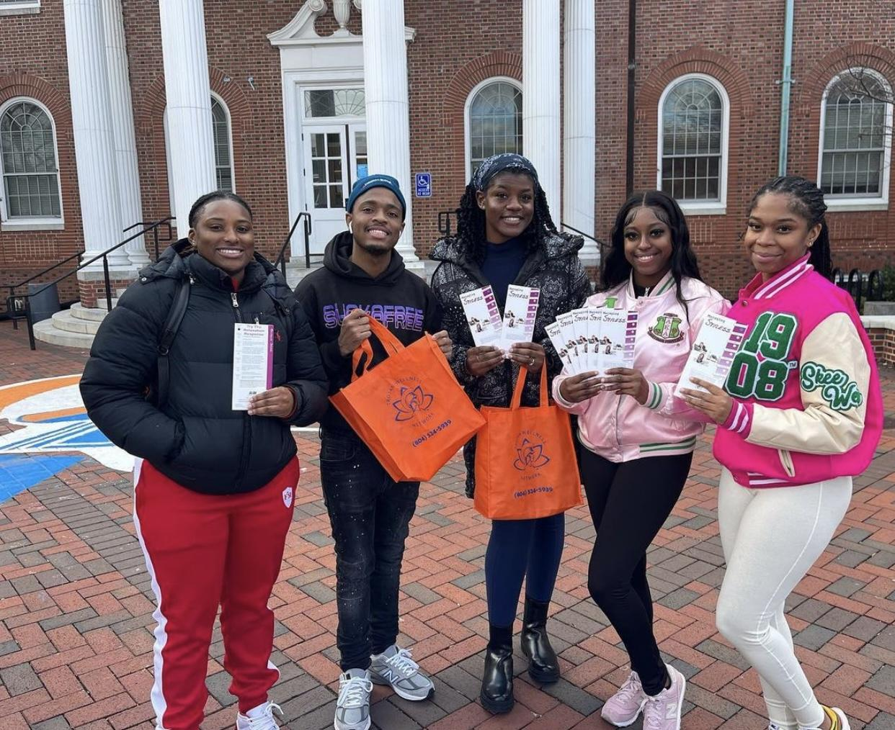
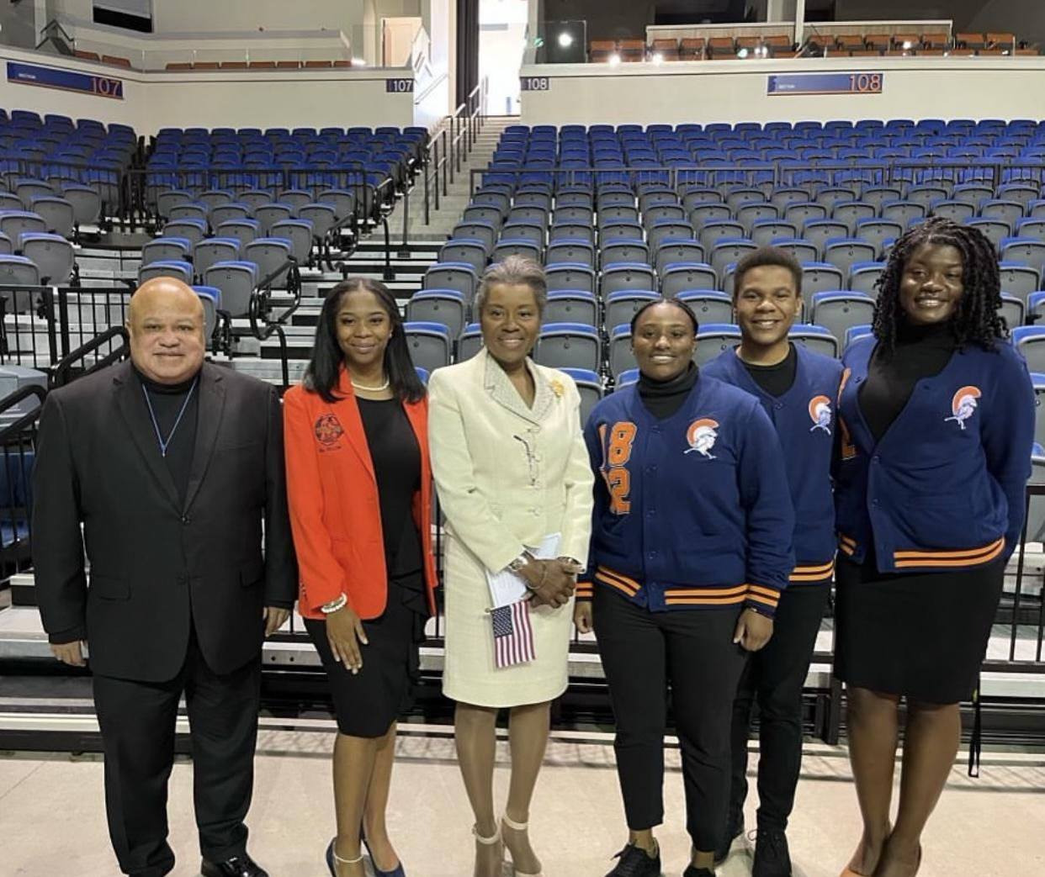
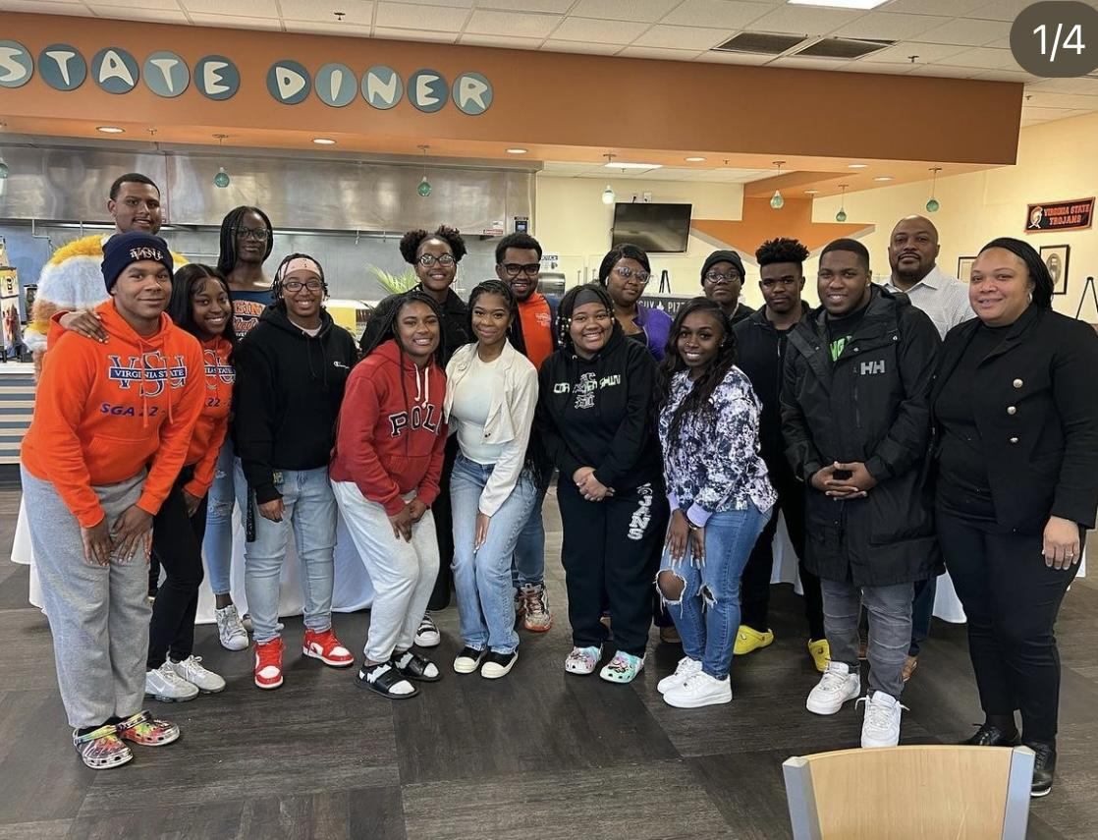

Slide 8
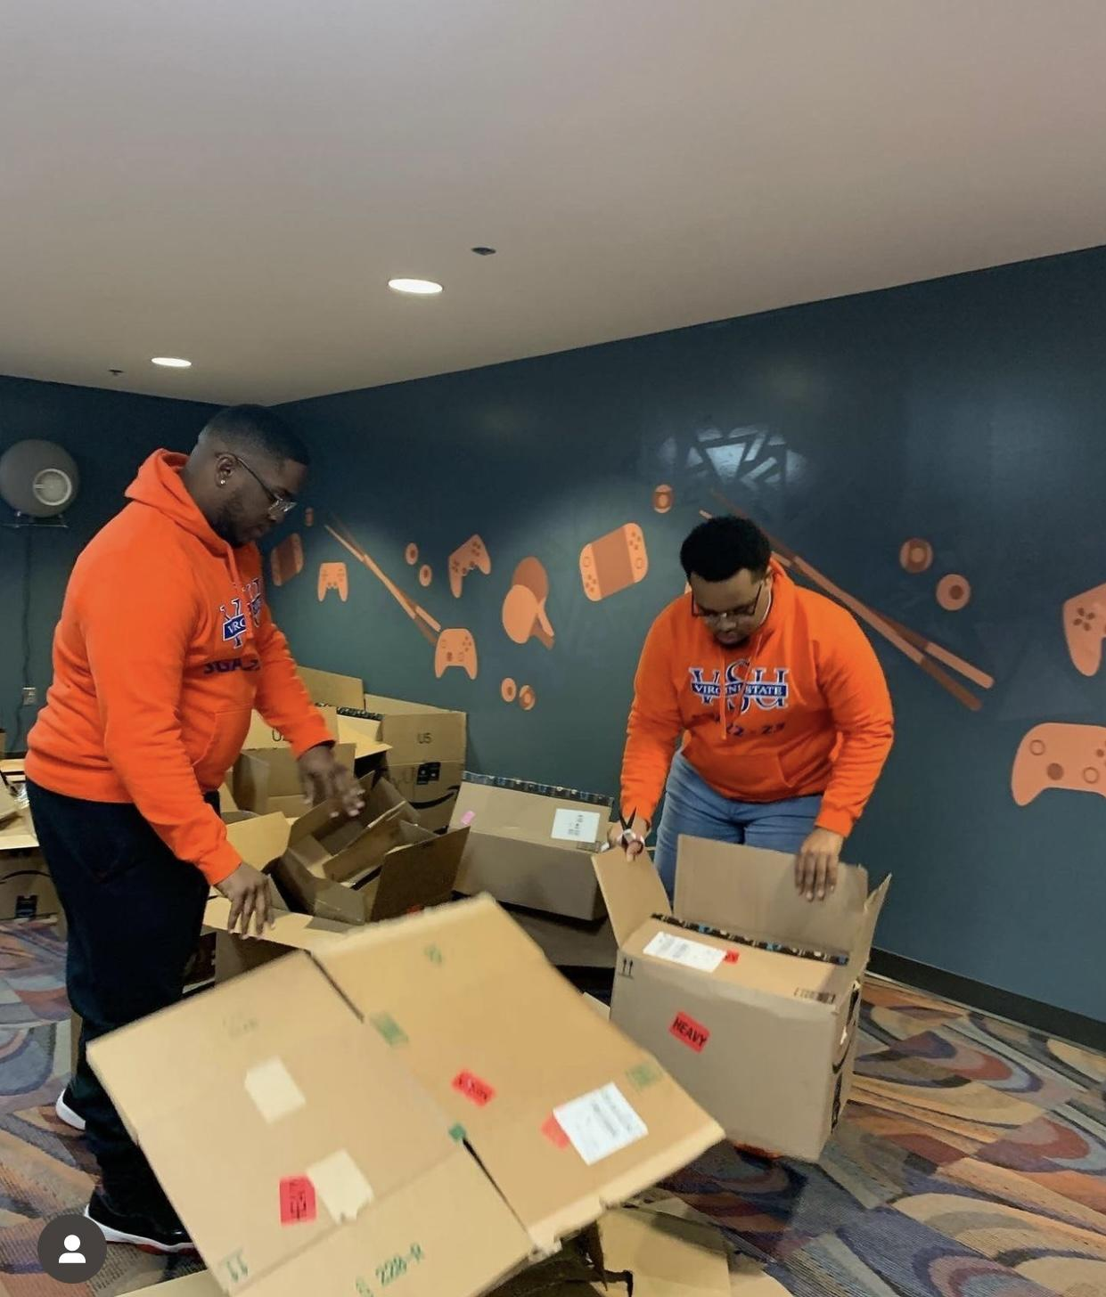
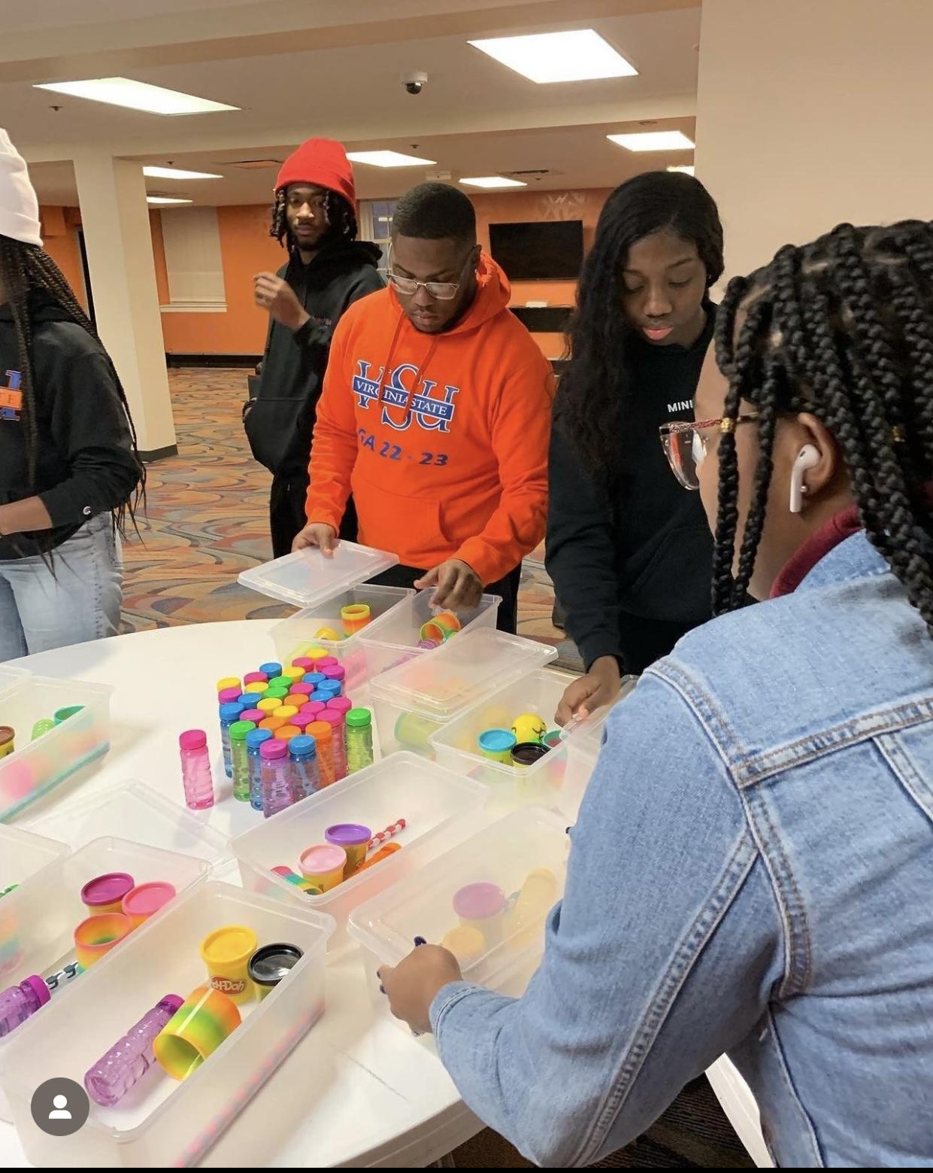
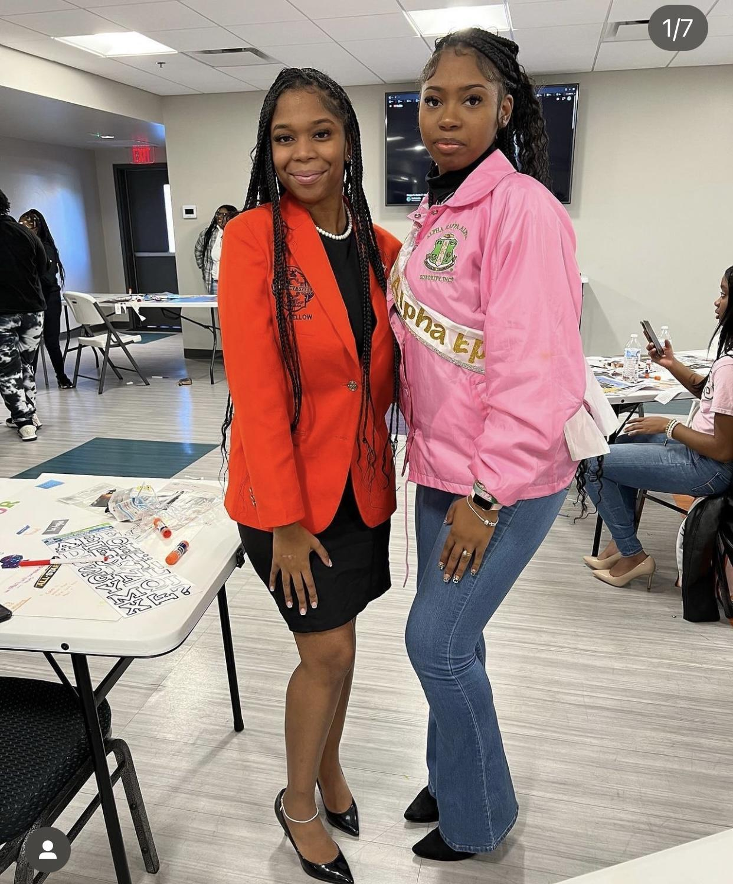
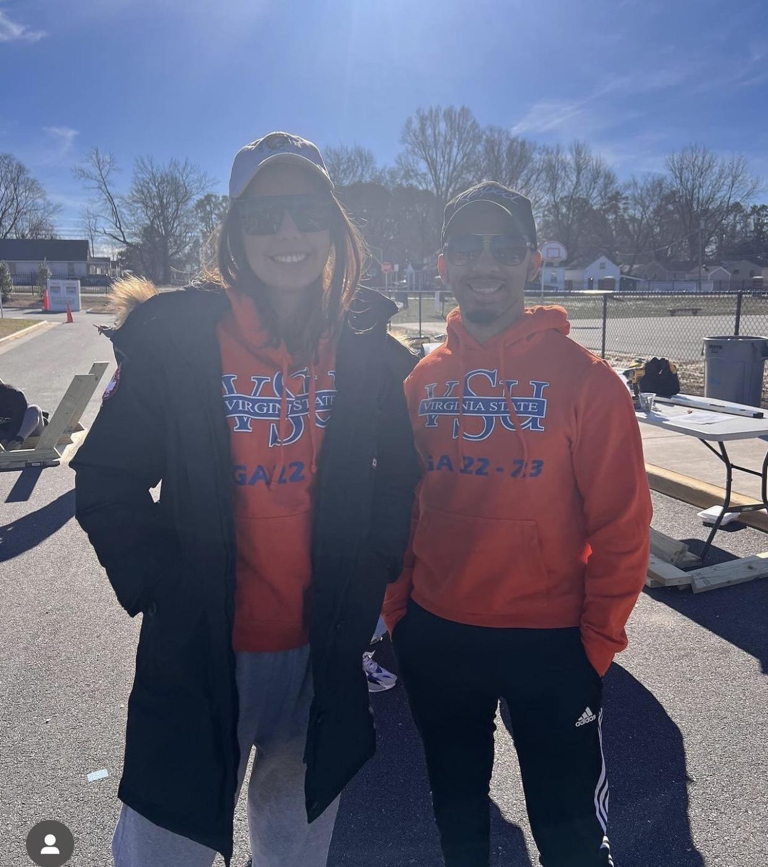
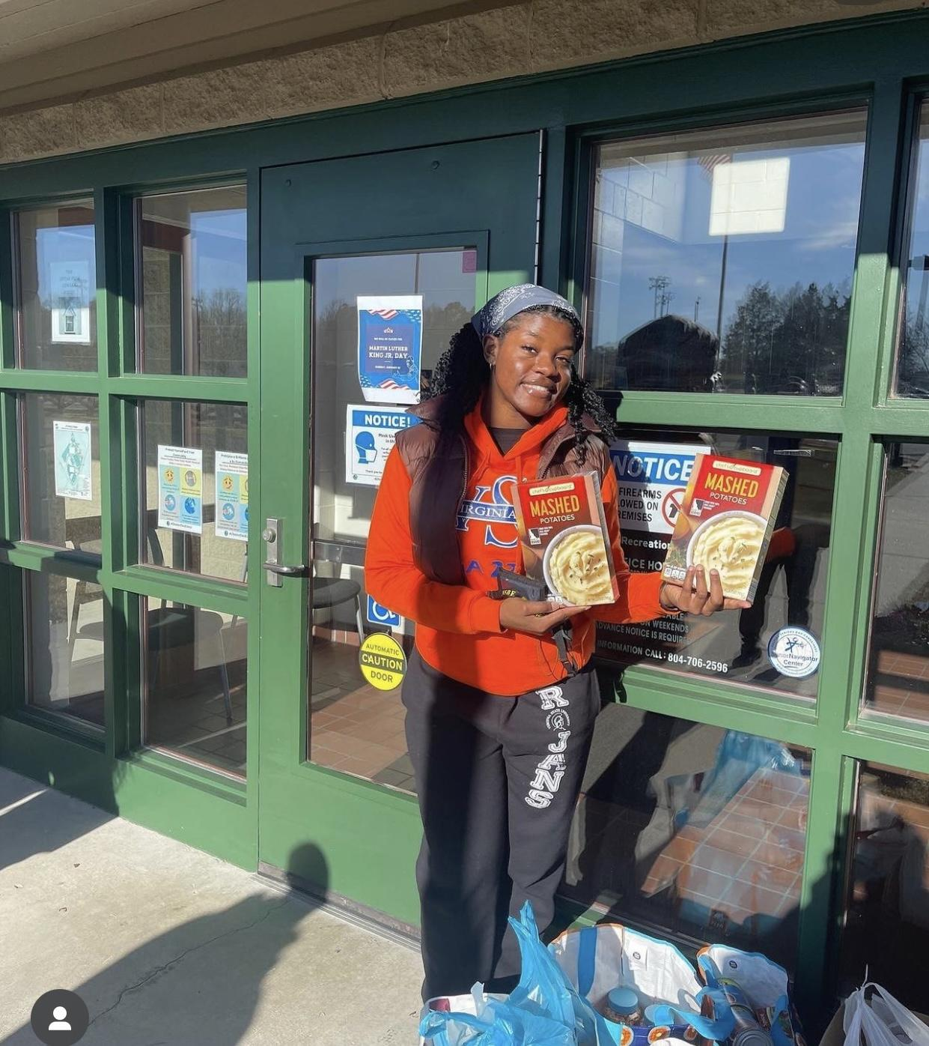
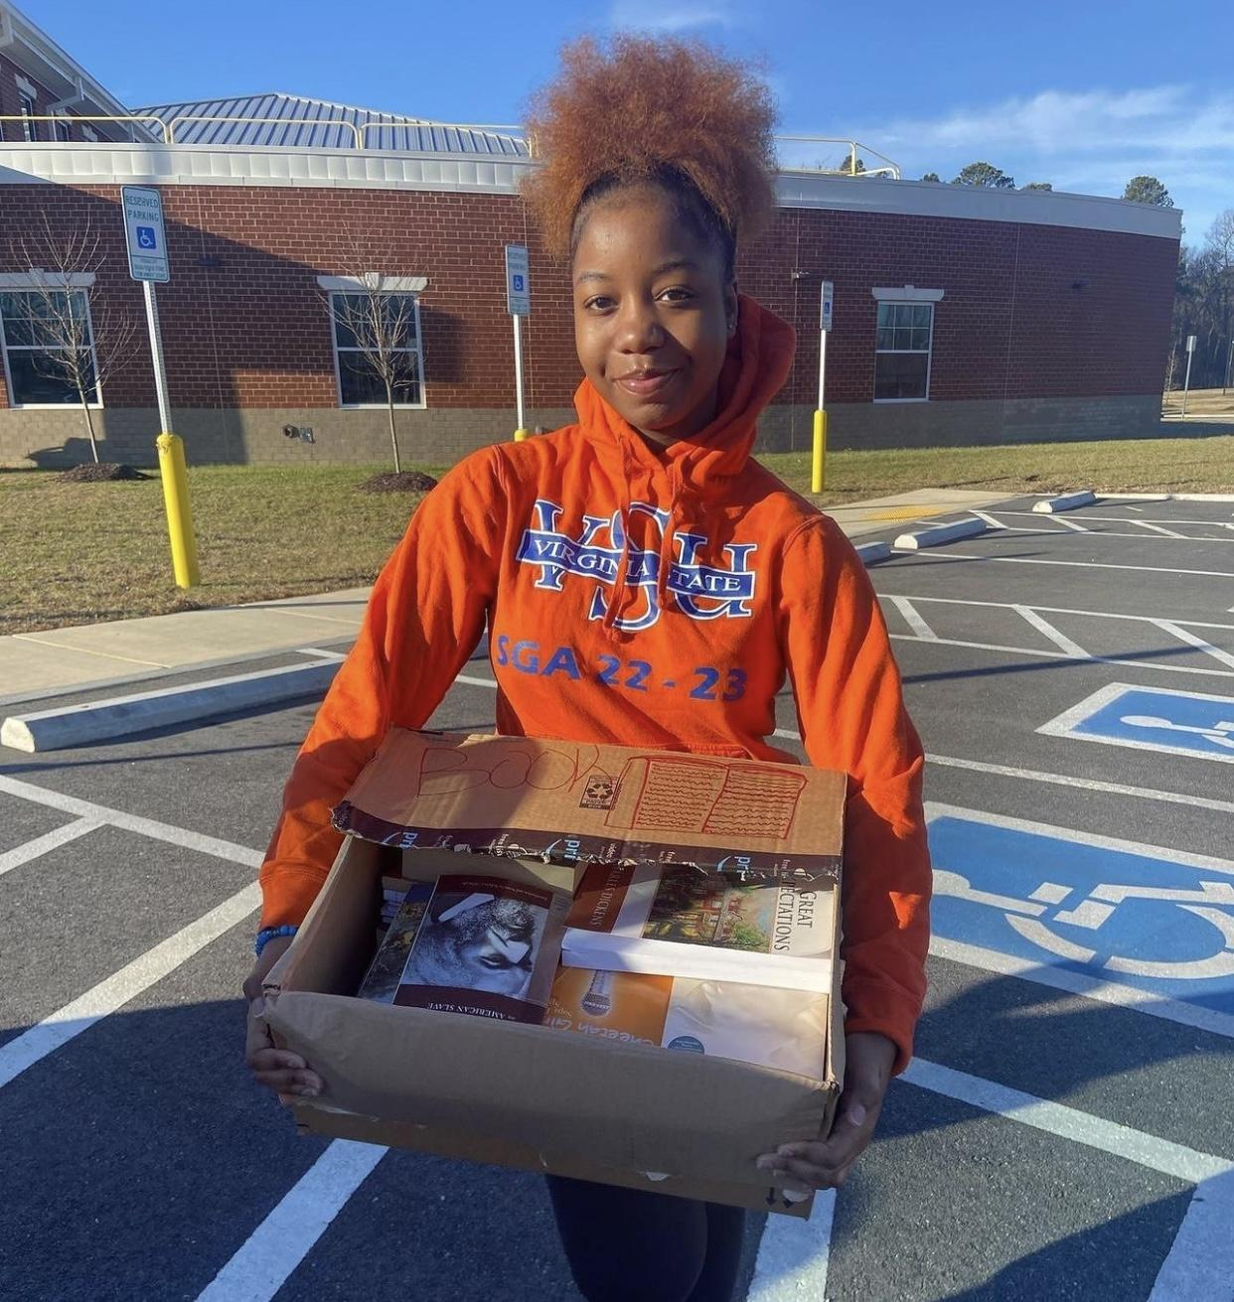

Slide 9
Current Issues
With commencement being split into two sections, students are unable to graduate together as a class
UAE Shuttle busses are not prompt to the schedule and are consistently making students late to class
The hours of the shuttle bus needs to be adjusted, the first shuttle bus to the hotel doesn’t start until 10 am, and students have classes before 10 am
Old residence halls are a consistent stress for students in the receiving of clean living spaces, hot water access, and faulty pipes and frequent leaks
Students would like more availability and options in their mental health counselors
Within student dorms the elevators utilized are constantly broken or under repair
Within student dorms the laundry dryers are constantly broken and need repair
Students would like the option of having more to go boxes within the cafeterias

Slide 10
Current Initiatives
Our Administration is currently working towards having an on campus beauty salon and barbershop
The Administration is working to implement Revolutionary Trips for students on campus
The Administration is proposing and working on a trip to Africa for students
The Administration is advocating for an on campus photo studio
We are working towards advocating for an arcade in Foster Hall
The Administration is working towards having a shuttle bus to Wawa and Cookout
The Administration is working towards an event in the multipurpose center to showcase student’s talent
We are currently advocating for dual enrollment programs in high schools to provide students VSU classes
The Administration is working towards putting together a V2 summit with Virginia State University and Norfolk State University
We are working on a “Anything is Everything” drive, in which we will donate clothes, hygiene items, and food to our neighboring communities.
Lastly, we are Advocating towards giving away four $500 scholarships to each class

Slide 11
Questions/Dialogue

Slide 12
Thank You For Your Time!

