Slide 1


Board of Visitors Report
April 25th-26th, 2024

Slide 2

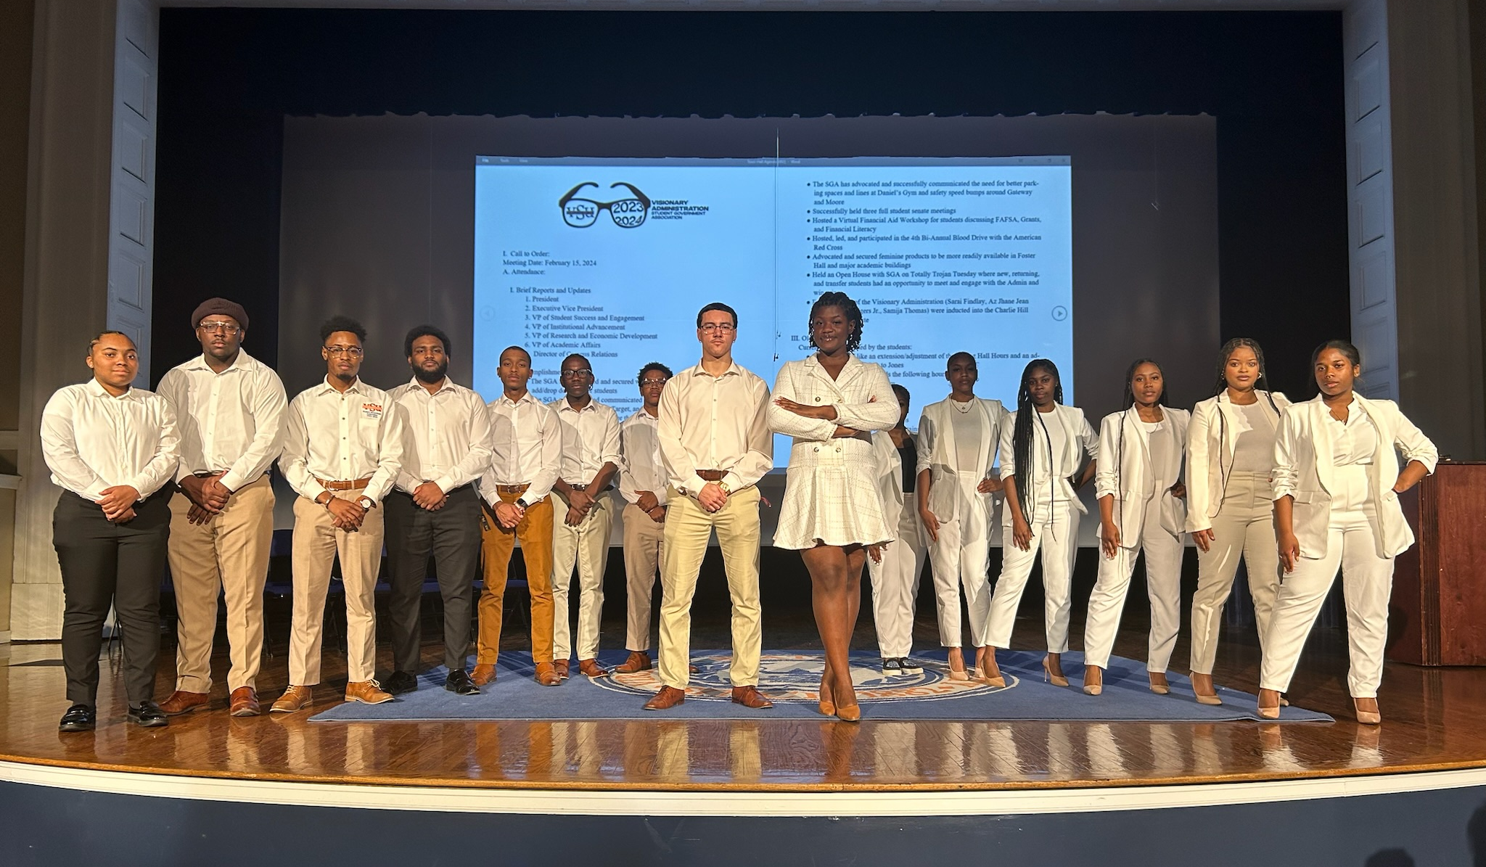
The Visionary Administration of the
Student Government Association

Slide 3

Goals-Mission-Values
Motto: We are the Vision Come to Fruition
Mission: To have VSU undergraduate and graduate students complete their degree(s) fully prepares for their life and career; having applicable skills, lessons, and experiences to propel them into the professional, academic, and social arena of life.
Brand: Servant Student Leadership. We are not above or below anyone. Change is achieved through advocacy and pressure.

Slide 4

Mid-Spring 2024 Semester Overview
The campus is very active and lively following the conclusion of Spring Fling, Academic Honors Ceremonies for the College Departments, and the new membership presentations for the Greek life on campus. Student are going to class, taking advantage of academic study sessions with tutors, participating in school activities, and living in the culture on the Hill. As the Academic Year winds down students are preparing for finals and look forward to graduation, internships, travel and the new experiences of summer break.

Slide 5
What is the SGA doing (February- April)
The SGA and Mister VSU successfully collaborated and hosted the 2nd VSU Marketplace event on April 5th.
Successfully held campus elections for the statement of the Student Government Association for the 2024-2025 Academic School year.
Successfully created and fulfilled the Visionary Scholarship for 2 VSU students for $1000 each.
2 SGA members completed the Ghana 3, traveling to Accra, Cape Coast, and Akropong Ghana to study abroad further ventures for students at VSU.
The Visionary Student Government Association has advocated and created a new source of funds to improve student concerns and issues on the conditions of campus and students beginning in the 2024-2025 school year.
Eight members of the Administration crossed into the Greek organizations. Kailyn Haye, Mia Anderson, Az-Jhane Jean Paul, and India Bundy joined the Alpha Epsilon Chapter of Alpha Kappa Alpha Sorority, Incorporated, Sarai Findlay and Jaila Walton joined Alpha Eta Chapter of Delta Sigma Theta Sorority, Incorporated, Malik Easterling joined the Nu Psi Chapter of Omega Psi Phi Fraternity, Incorporated, and Seven Jones and Adonis Payton joined the Alpha Phi chapter of Kappa Alpha Psi Fraternity, Incorporated.
Successfully planned the 50th. Legacy Extravaganza set for April 20th. from 6 p.m. -9 p.m. in Gateway Dining and Event Center. Proceeds will go to two student scholarships.
SGA has been able to advocate for financial assistance to a student organization during the 2024-2025 academic year by funding an event in Anderson Auditorium covering venue, security, lighting, and fees.
Notes:
November
Silent Headphone party with VSU’s Academic Center for Excellence
December
-Financial Aid workshop virtual workshop: FASCA, Grants, Financial Literacy, and scholarship application assistance
-
Accomplishments:
Extended the add/drop period for students by a day
Shuttle Schedule for Walmart-Target-Mall

Slide 6
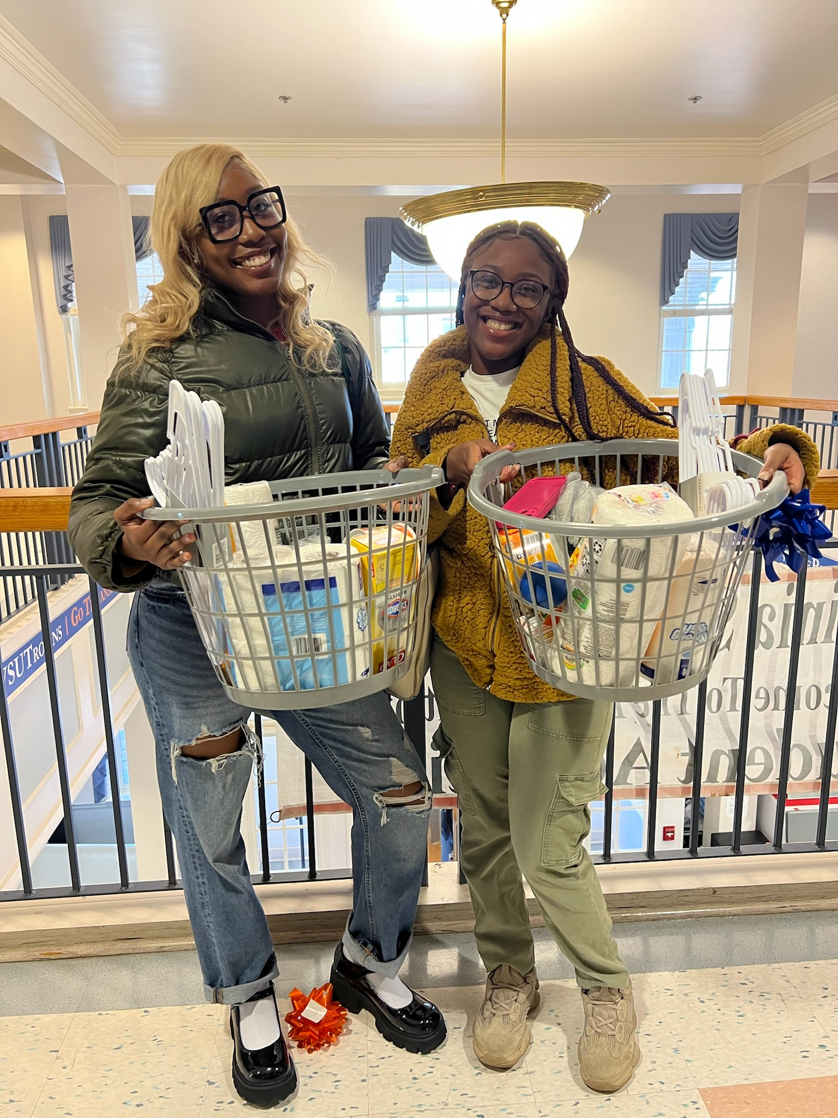
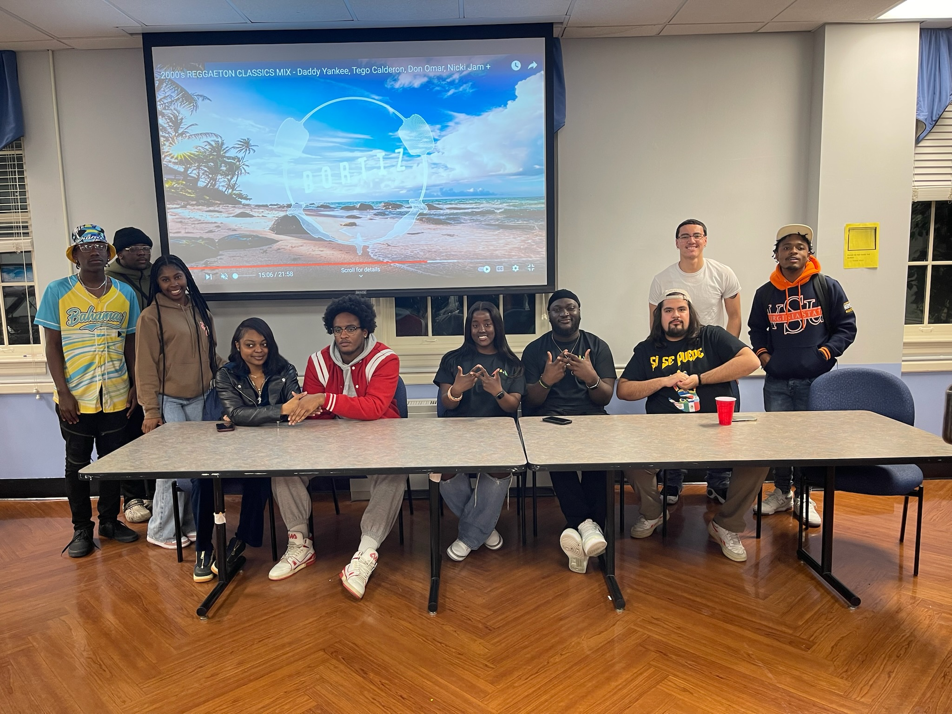
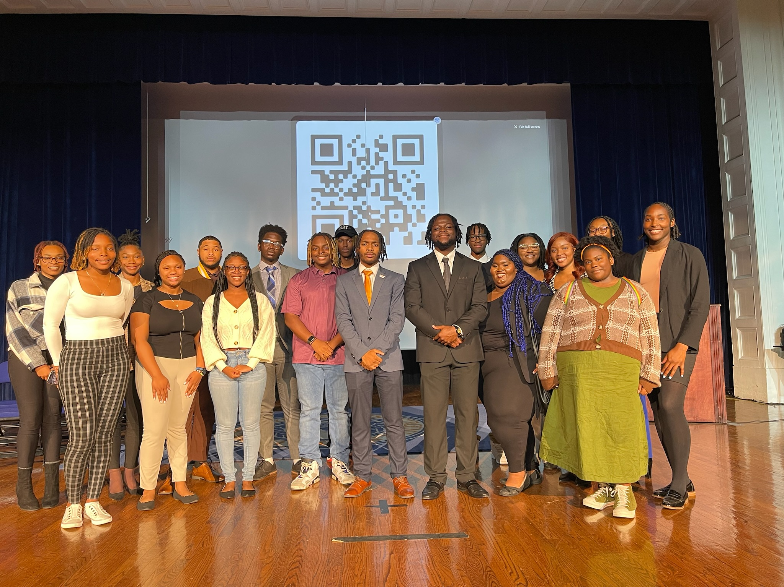
What is the SGA doing now (January-February)

Slide 7
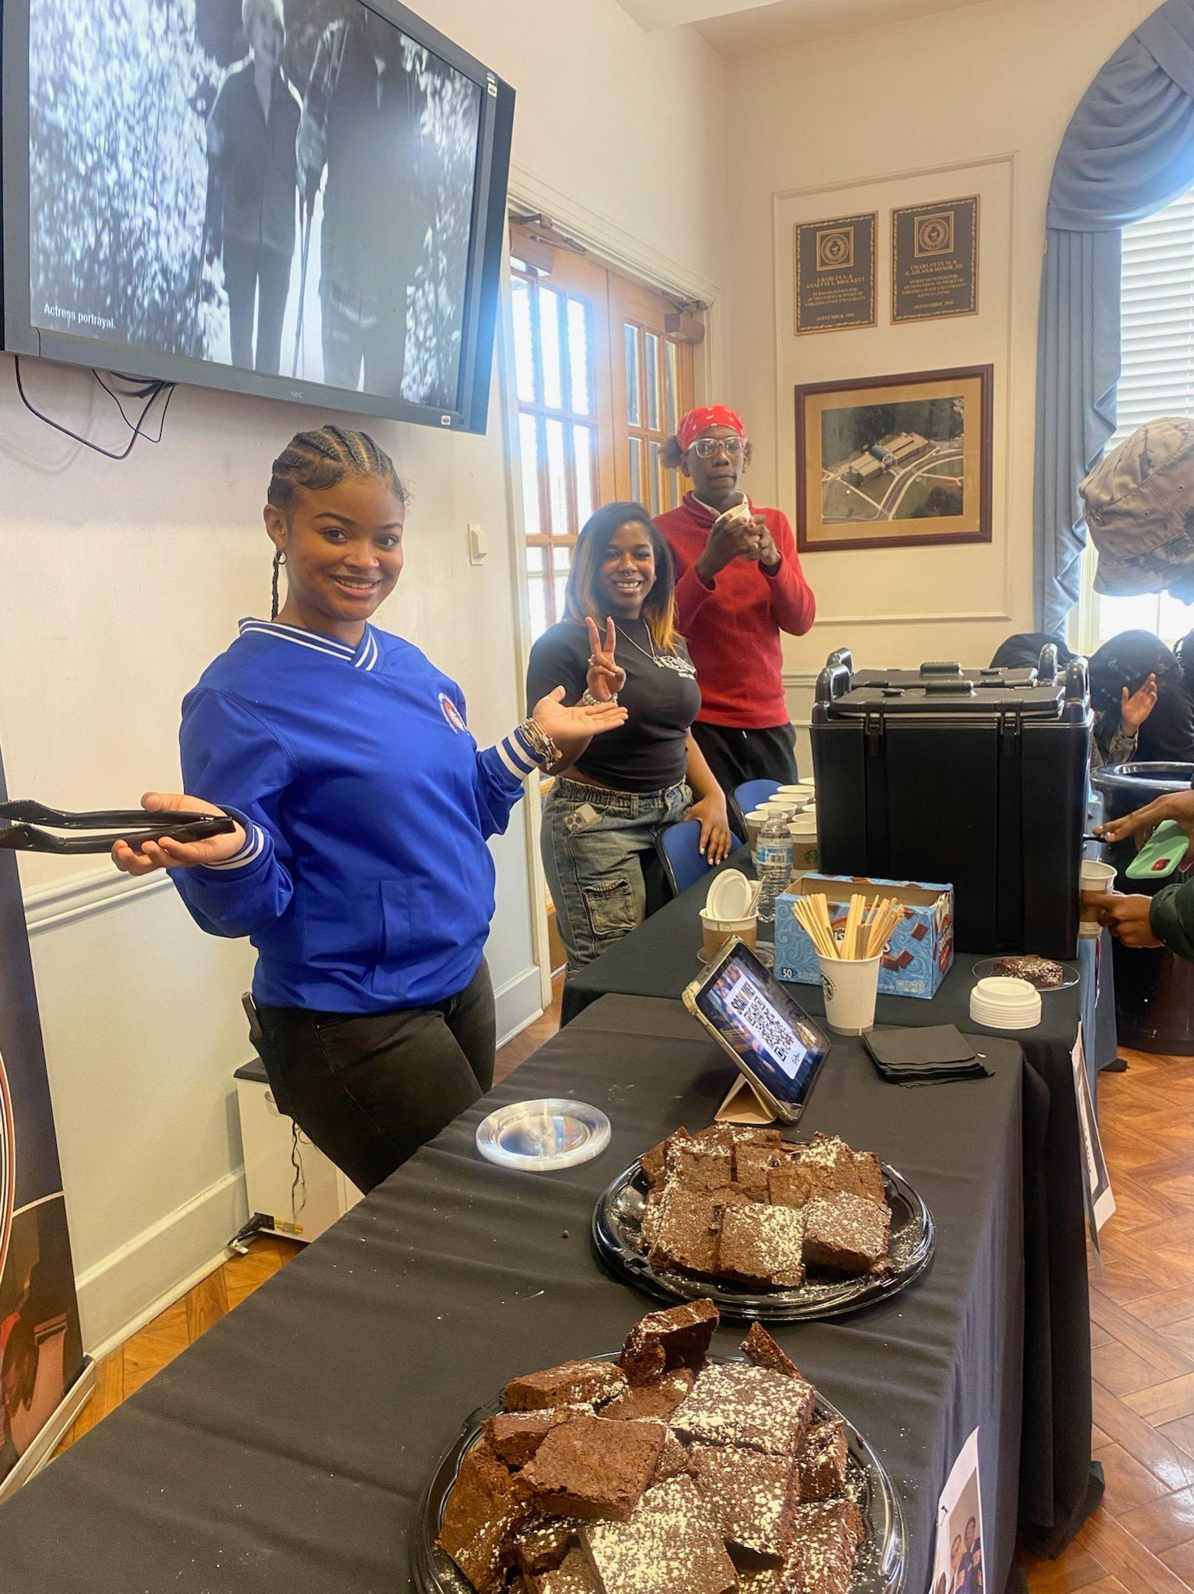
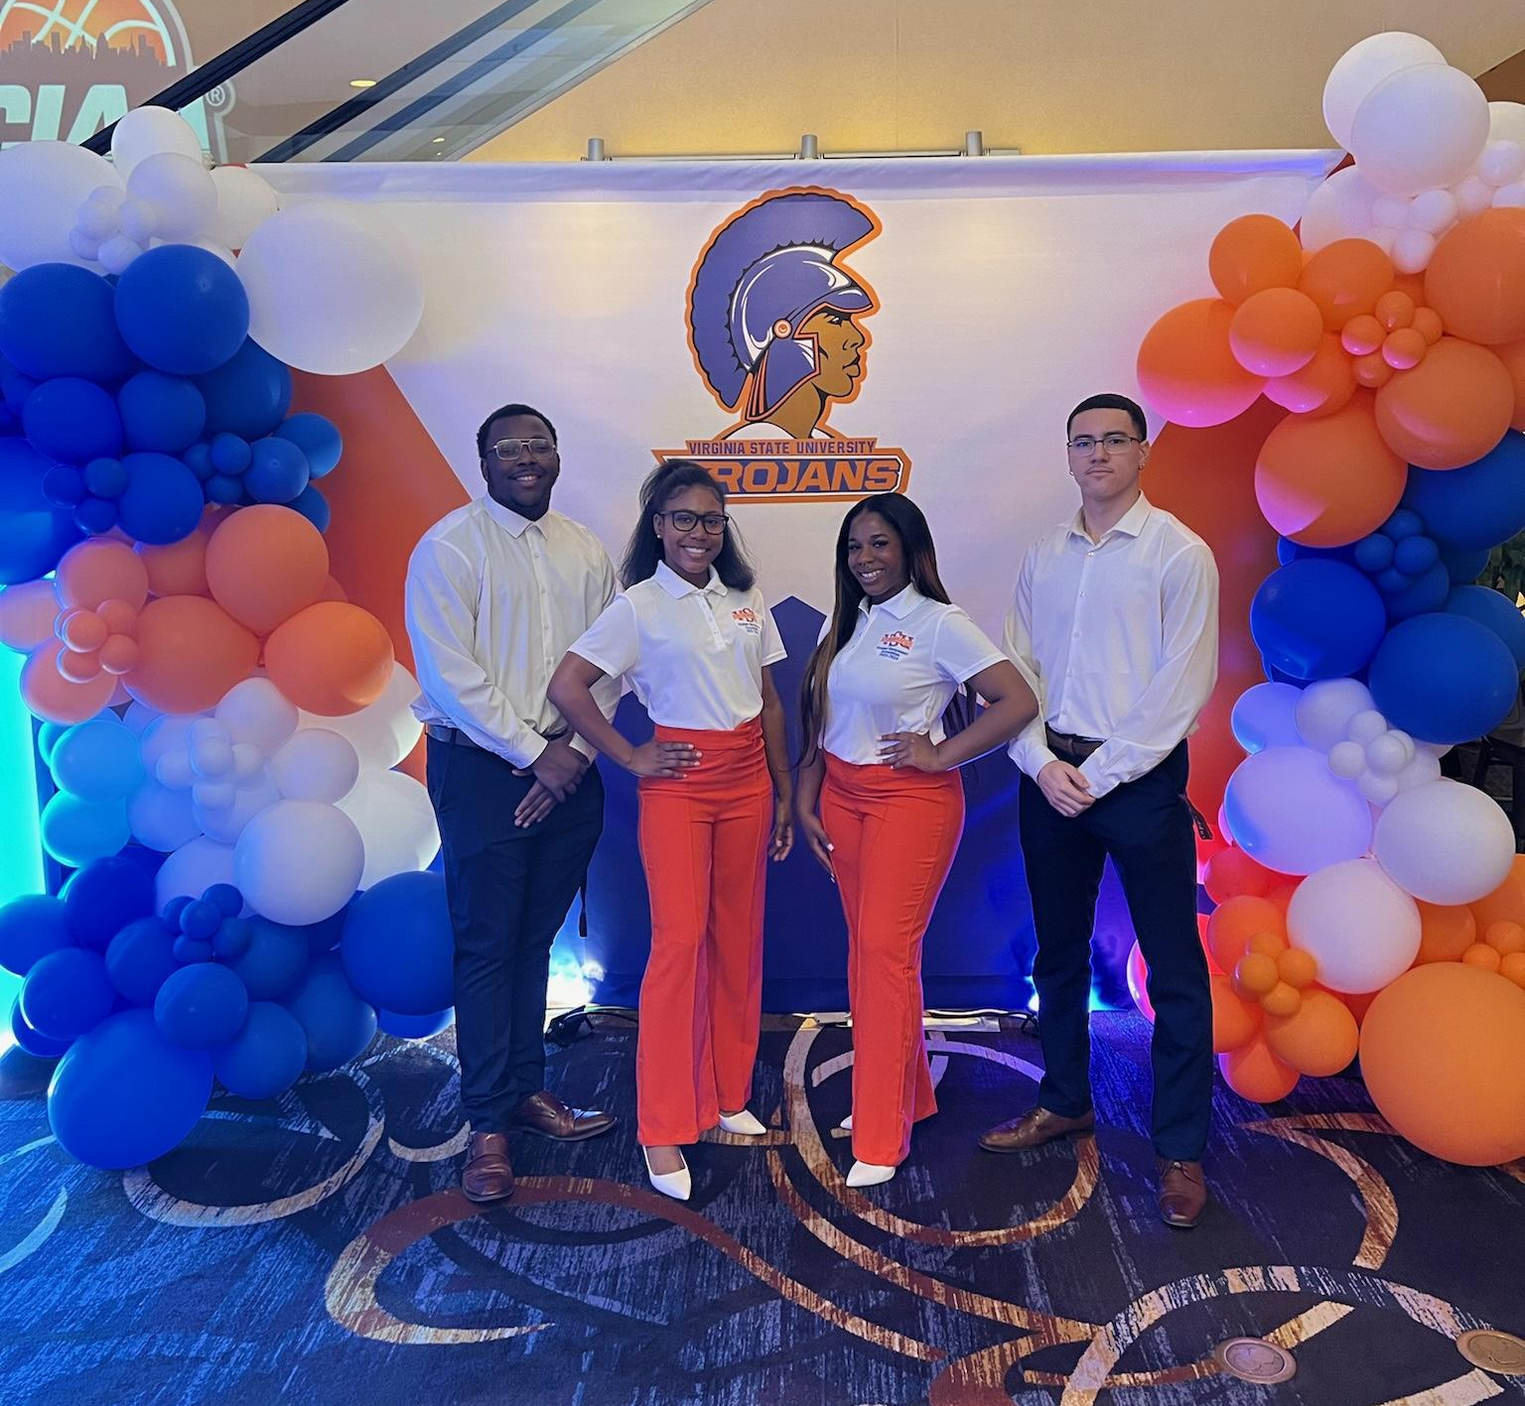
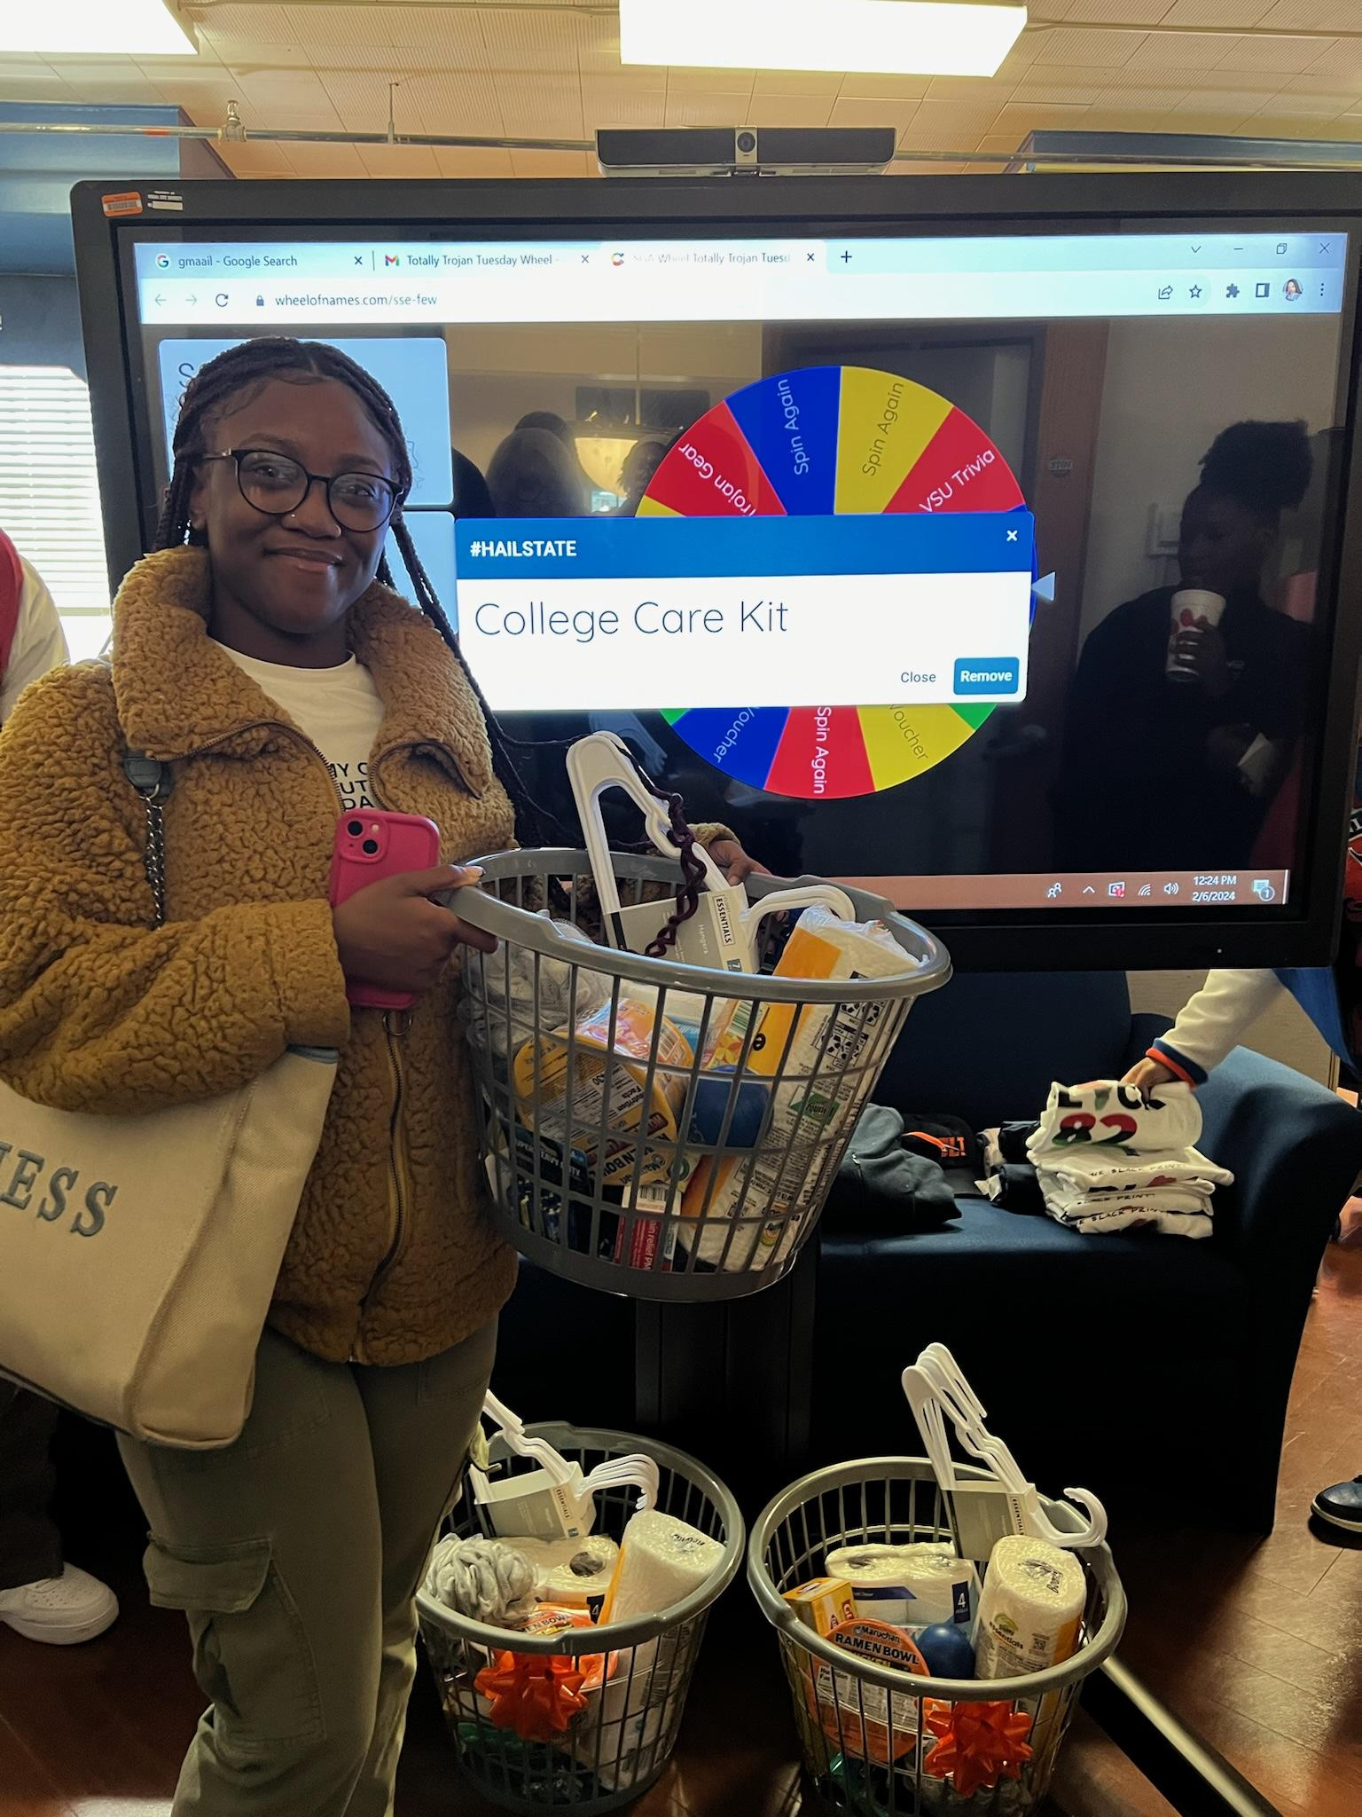
What is the SGA doing now (January-February)

Slide 8

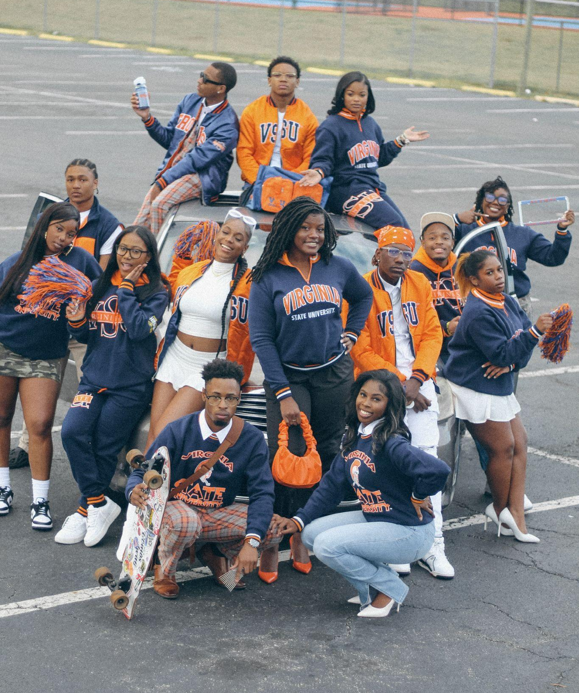
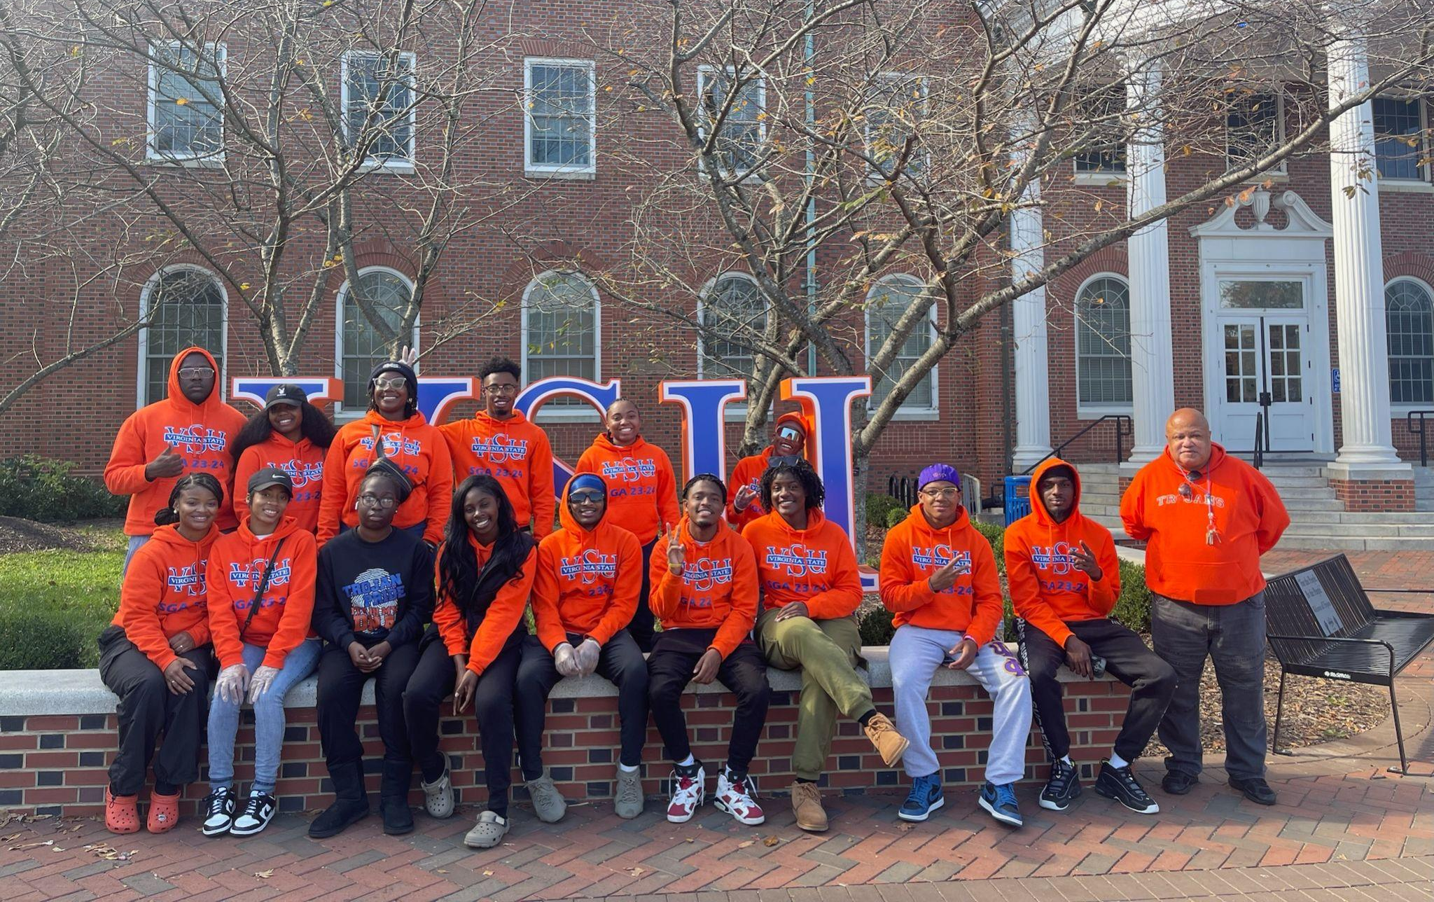

Slide 9
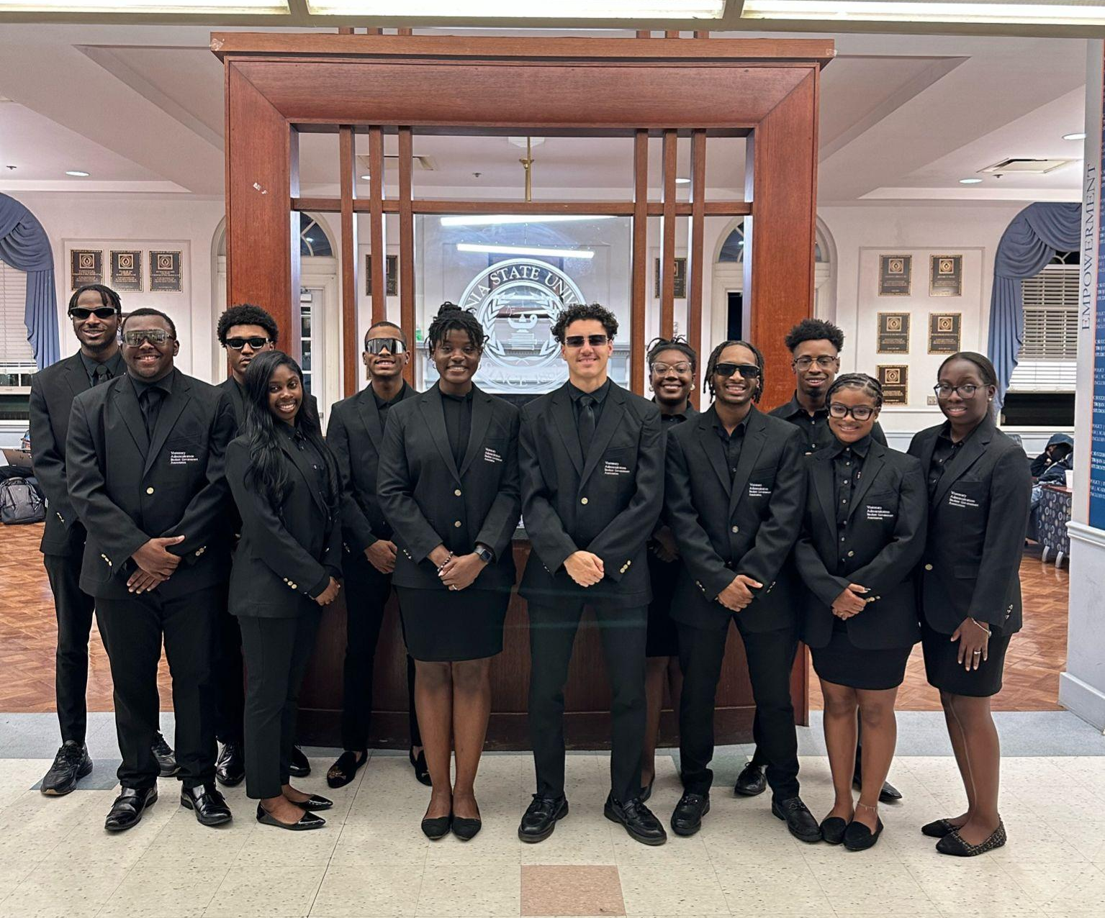
Current Initiatives
50th SGA Legacy Celebration Extravaganza for April 20th.
  $1000 a table, $50 a ticket for faculty and staff, Free for students
Faculty and Staff Appreciation Day
Financial Wellness and life courses for students

Slide 10
Current Issues
Longer library hours, 5 am - 3 am coverage for the week of April 22-May 3, 2024.
Students want more information on the Accessibility Office and how the office meets student’s needs.
Students are concerned about the lack of parking for students and faculty.
Students are dissatisfied about the increase in tuition and fees beginning the 2024-2025 Academic School Year.

Slide 11
Questions and Dialogue

Slide 12
Thank you for your time!

