Slide 1
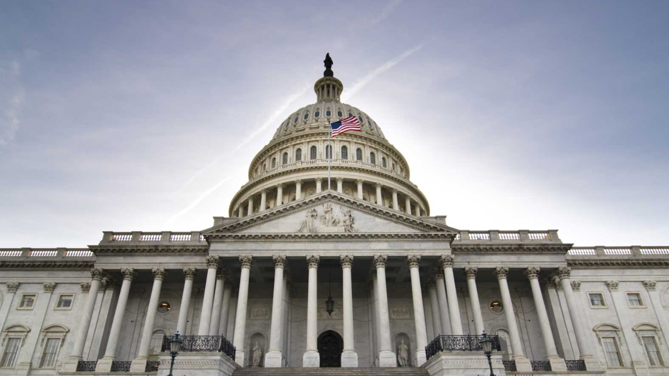
Government Relations Update
Eldon Burton
Virginia State University
February 2021
Notes:
Start with an official introduction of myself and my journey to this position.

Slide 2
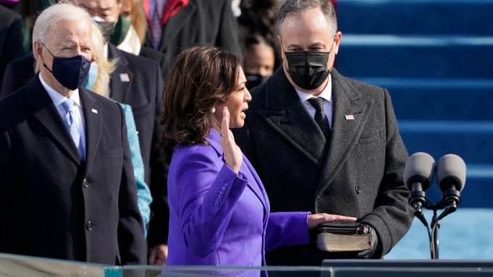

Slide 3
Coronavirus Response and Relief Supplemental Appropriations Act (CRRSAA)
Higher Education Emergency Relief Funds (HEERF II) - $21.2 Billion
VSU Allocation - $10.7 Million
HBCU/MSI Allocation – $1.7 Billion
VSU HBCU Allocation – $TBD

Slide 4
Governor’s Budget Amendments for FY 2022
Restored $6.2 million for VSU program
Restored $1.5 million for VSU Cooperative Extension State Match
Added $34 million for VSU to improve HVAC campus-wide for infectious aerosol control

Slide 5
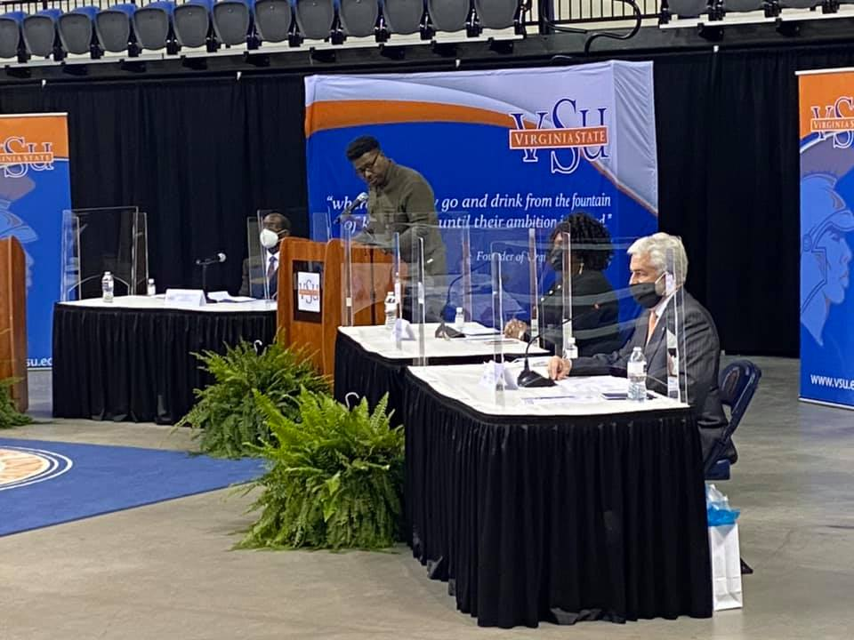
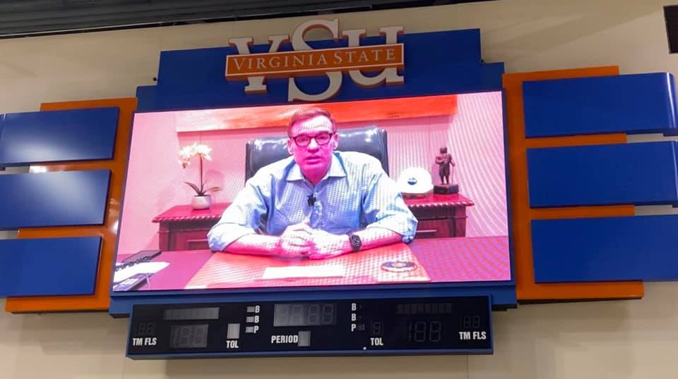

Slide 6
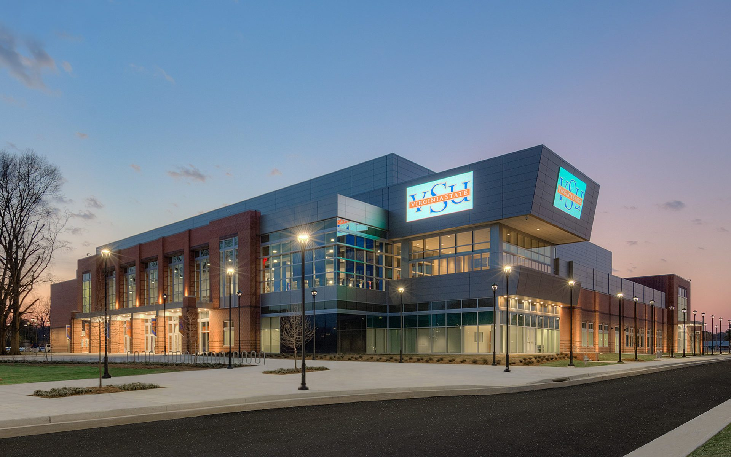
Questions?

